Slide 1
RRAT – Dredging Update
Gilbert Island Post Construction
Flex Pipe Update
Flex Pipe use
2014 Dredging Update
Dredge Master Plan

Slide 2
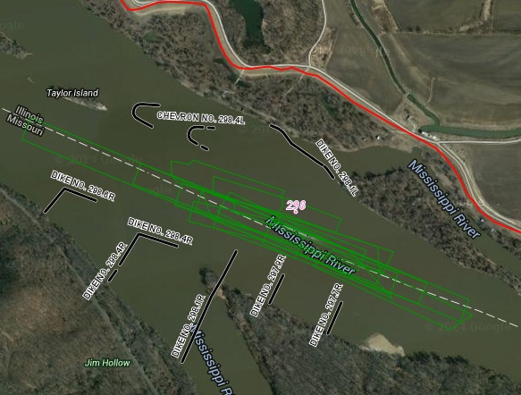
Gilbert Island, Mile 298 UMR
Recent Dredging History 2005 – 2010
Total 510k CY, Average 101k CY, Average 7 days
Chevrons constructed 2011
No Dredging after construction
Estimated savings $300k to $500k.

Slide 3
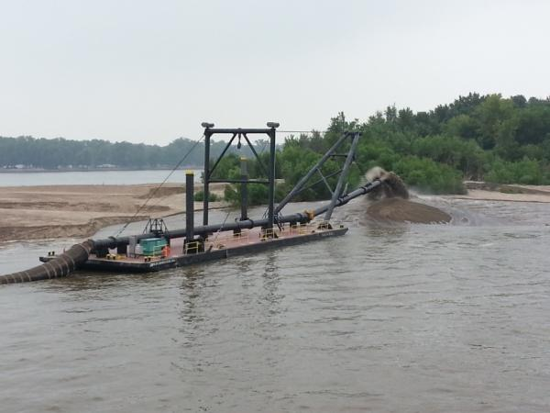
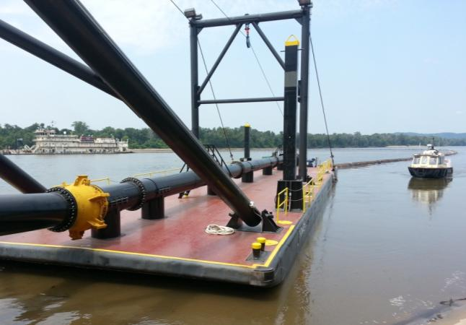
Flex Pipe - Update
+ Completed Thomas N. George Spill Barge
+ Quick Connect Demo, & in use.
Need 6 more quick connects.
Need swivel ball joint at spill barge
Off season storage
Notes:
Dredge Potter and new Thomas N. George spill barge showing fixed point placement with a dustpan dredge.

Slide 4
Flex Pipe - Use
+ Mel Price Pool – all 7 dredging locations (221, 227, 229, 235, 237, 240, 241)
+ Lower River
Planned at mile 173
Possibly mile 24 & other assignments until cold weather
Buffalo Island mile 25 – 26
+ Lower River 2013
Manskers, 104 – 103 UMR, 11-26 Sep 2013
100k into Chevron at 104, 200k into Island
Notes:
Dredge Potter and new Thomas N. George spill barge showing fixed point placement with a dustpan dredge.

Slide 5
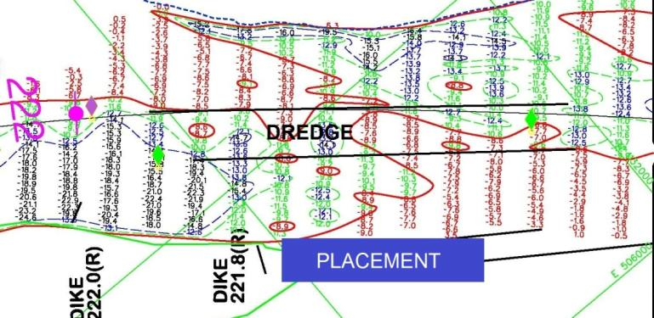
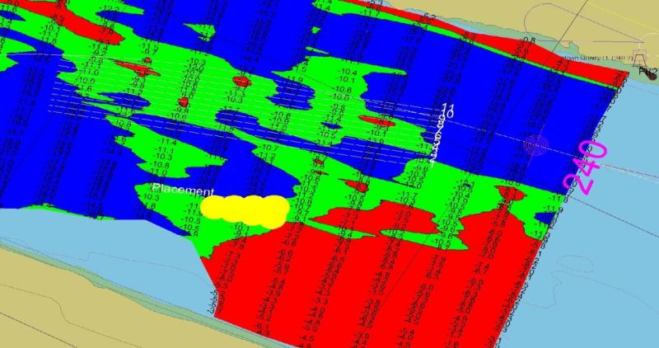
Dredge Potter Flex Pipe Fixed Point Placement
Allows Potter to reach preferred placement areas.
Avoid sensitive habitat areas
Create islands vs sidecasting
Notes:
Dredge Potter and new Thomas N. George spill barge showing fixed point placement with a dustpan dredge.

Slide 6
2014 Dredge Update
Dredge Potter
Mel Price Pool, 1 Aug 2014 – 27 Aug, 854k CY.
7 locations: 221, 227, 229, 235, 237, 240, 241.
Pool 25. 27 Aug – 1 Sep. 222k CY.
Miles 252, 256, 270
Lower River (Open River)
1 location complete, mile 169.
High water delays.
Dredge Bill Holman (LRL Contract)
SEMO Port, 3 – 6 September, 64k CY.
Kaskaskia Mouth, 7 – 13 September, 109k CY.
Dredge Goetz (St. Paul District)
Illinois Waterway, 26 Sept to approx 13 Oct, (mile 79 – 75)
2013 Quantities: Potter 6.6M CY, America 1.5M CY

Slide 7
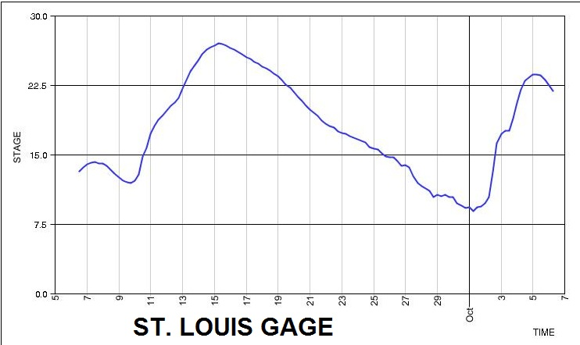
2014 Dredge Update
High Water delays, only 1 assignment completed to date, mile 169 UMR, on Lower River
Schedule Impacts (Only 1 location complted to date)

Slide 8
Dredge Master Plans
+ July 31st Meeting with USFW, MDOC, IDNR
+ Documented preferred placement for routine dredging areas.
+ Identified dredging areas for flex pipe use.
Need to finalize, working on template..
ILW Master Plan.

