Slide 1
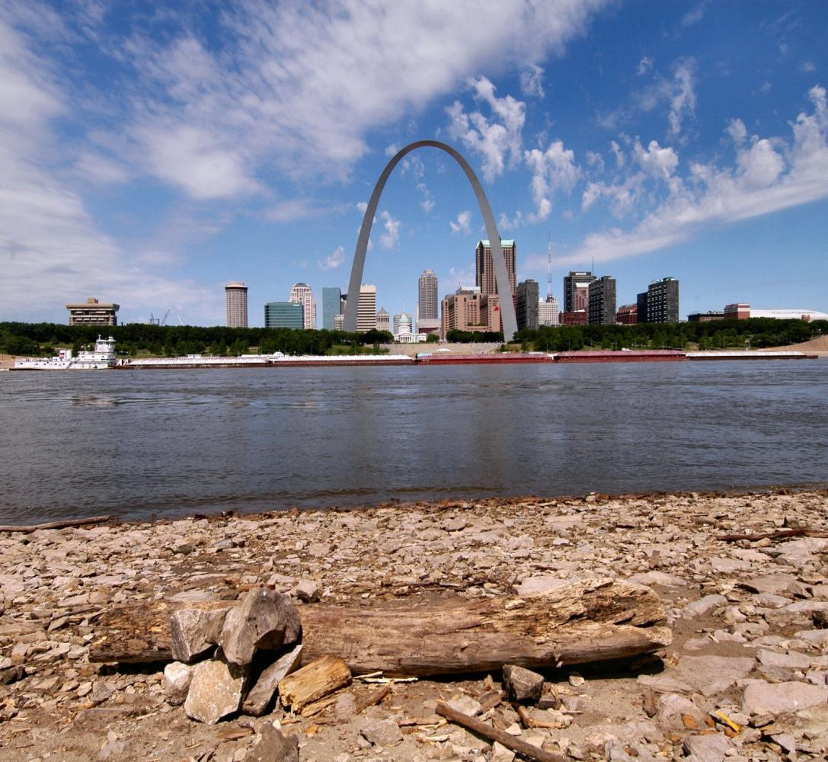
St. Louis District Water Control Operations
Joan Stemler
October 8th, 2014

Slide 2
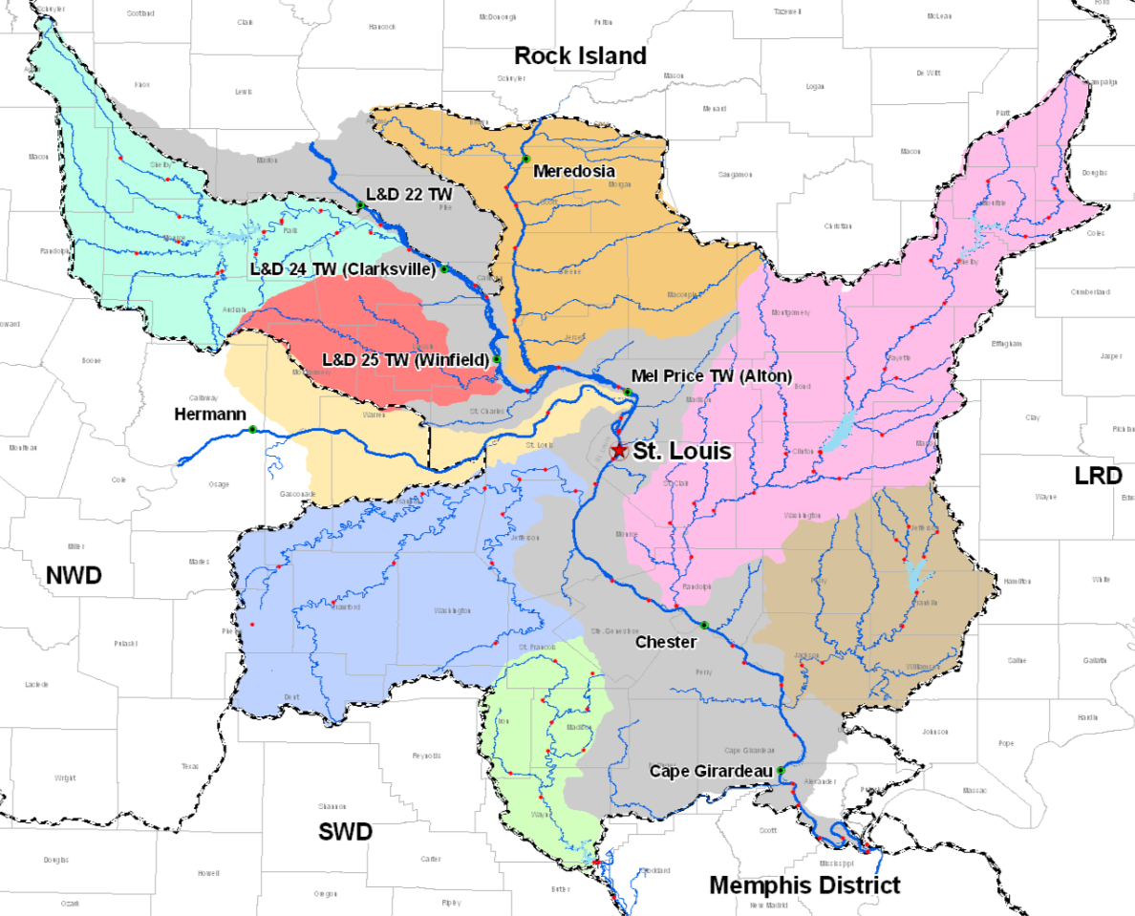
St. Louis District
Mark Twain Lake
Illinois River
Lake Shelbyville
Missouri River
Carlyle Lake
Rend Lake
Mississippi River
Wappapello Lake

Slide 3
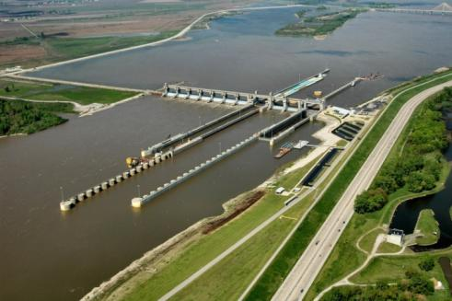
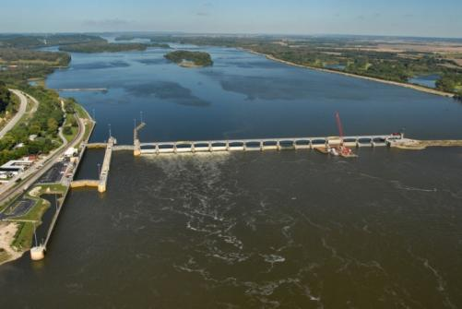
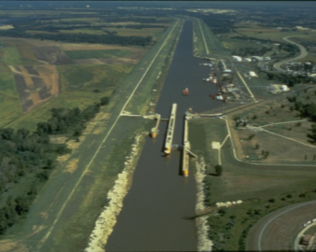
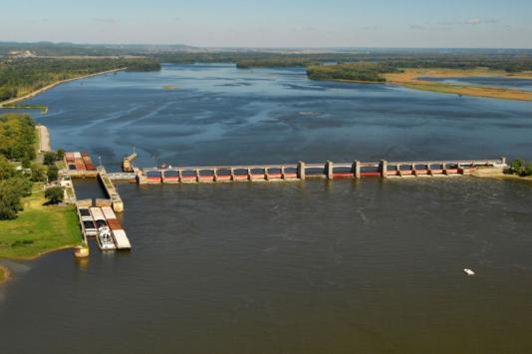
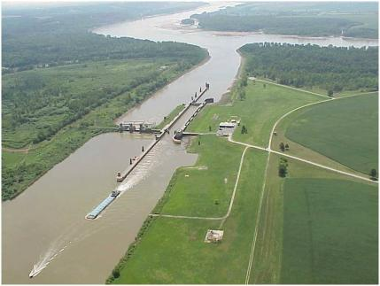
Locks and Dams
Melvin Price
Locks & Dam
L&D 24
Illinois River
Locks 27
Missouri River
Mississippi River
Kaskaskia L&D
L&D 25

Slide 4
Locks and Dams
Dam Point Control vs Hinge Point Control
Dam Point Control
The Navigation Pool is regulated at the Lock and Dam within 0.5 to 1.0 ft band limits
Hinge Point Control
The Navigation Pool is regulated from two points, the Lock and Dam and a location in the pool

Slide 5
Hinge Point Operation
Lock and Dam 24
Pool Limits: 445.5 - 449.0
Hinge Point Limits, Louisiana: 11.5 - 12.2 (May be exceeded if at maximum drawdown)
Lock and Dam 25
Pool Limits: 429.7 - 434.0
Hinge Point Limits, Mosier Landing: 434.0 - 437.0 (May be exceeded if at maximum drawdown)
Melvin Price Locks and Dam
Pool Limits: 412.5 - 419.0 Alton Lower Limit: 414.0
Hinge Point Limits, Grafton: 14.2 - 16.2 (May be exceeded if at maximum drawdown, or Alton at 414.0)
Kaskaskia Lock and Dam
Pool Limits: 363.0 - 368.8
Hinge Point, Red Bud: 368.0 - 370.0

Slide 6
Lock and Dam 24
Pool Limits: 445.5 - 449.0
Hinge Point Limits, Louisiana: 11.5 - 12.2 (May be exceeded if at maximum drawdown)
L&D 22
RM – 301.2
Louisiana
RM – 282.9
L&D 24
RM – 273.5
12.2
449.0
11.5
445.5
Low Flow / Flat Pool

Slide 7
Lock and Dam 24
Pool Limits: 445.5 - 449.0
Hinge Point Limits, Louisiana: 11.5 - 12.2 (May be exceeded if at maximum drawdown)
L&D 22
RM – 301.2
Louisiana
RM – 282.9
L&D 24
RM – 273.5
12.2
449.0
11.5
445.5
Maximum Drawdown

Slide 8
Lock and Dam 24
Pool Limits: 445.5 - 449.0
Hinge Point Limits, Louisiana: 11.5 - 12.2 (May be exceeded if at maximum drawdown)
L&D 22
RM – 301.2
Flow
Louisiana
RM – 282.9
Government Owned Flowage Easements
Low Flow / Flat Pool
L&D 24
RM – 273.5

Slide 9
Lock and Dam 24
Pool Limits: 445.5 - 449.0
Hinge Point Limits, Louisiana: 11.5 - 12.2 (May be exceeded if at maximum drawdown)
L&D 22
RM – 301.2
Flow
Louisiana
RM – 282.9
Government Owned Flowage Easements
L&D 24
RM – 273.5
Maximum Drawdown

Slide 10
Environmental Pool Management
An active program within the St. Louis District since 1994
Optimize pool regulation to maximize environmental benefits
1994 Annual Spring Coordination Meeting
BUILDING STRONG_{SM}

Slide 11
Environmental Pool Management
Provision of a safe and dependable navigation channel.
BUILDING STRONG_{SM}

Slide 12
Environmental Pool Management
2. Utilization of the following vegetative growth parameters:
a. Employ a pool drawdown of at least 0.5 feet for at least 30 days.
b. Employ a pool drawdown from the 1st of May to the 30th of July, as this period is the most suitable for vegetative growth and seed production.
c. After the initial drawdown, allow the pool to rise at a rate no greater than 0.1 - 0.2 foot per day. Vegetation will grow at a rapid rate if not overtopped by water and if a slow pool rise is provided.

Slide 13
Environmental Pool Management
Important Feature: Close coordination with resource managers in the field who provide valuable insight into actual conditions, and at times provide significant suggestions relative to needed adjustments. As with any natural process the vegetative response will vary from year to year (time of year, temp, and precip all have an effect)

Slide 15
Environmental Pool Management Examples

Slide 16
Lock and Dam 24 - 1994

Slide 17
Lock and Dam 25 - 1994

Slide 18
Mel Price Lock and Dam - 1994

Slide 19
Lock and Dam 24 - 1995

Slide 20
Lock and Dam 25 - 1995

Slide 21
Mel Price Lock and Dam - 1995

Slide 22
2008
Since 1994 we have been able to achieve yearly environmental benefits until 2008 when we had to abandon the process due to channel conditions.
Since 2008, years 2010, 2013, and 2014 were additional years where the complete process had to be abandoned due to channel conditions and flooding.

Slide 23
Lock and Dam 24 - 2008

Slide 24
Lock and Dam 25 - 2008

Slide 25
Mel Price Lock and Dam - 2008

Slide 26
Lock and Dam 24 - 2009

Slide 27
Lock and Dam 25 - 2009

Slide 28
Mel Price Lock and Dam - 2009

Slide 29
Lock and Dam 24 - 2010

Slide 30
Lock and Dam 25 - 2010

Slide 31
Mel Price Lock and Dam - 2010

Slide 32
Lock and Dam 24 - 2011

Slide 33
Lock and Dam 25 - 2011

Slide 34
Mel Price Lock and Dam - 2011

Slide 35
EMP 2014

Slide 36
EMP 2014

Slide 37
EMP 2014

Slide 38
Emergent Aquatic Vegetation
-Ellis Bay – near Ellis Island/ Hwy 367.
-Photos taken 7/2/14.
-416.0 relative to Mel Price L&D HW gage.
Normal pool = 419.0 relative to Mel Price L&D HW gage.

Slide 39
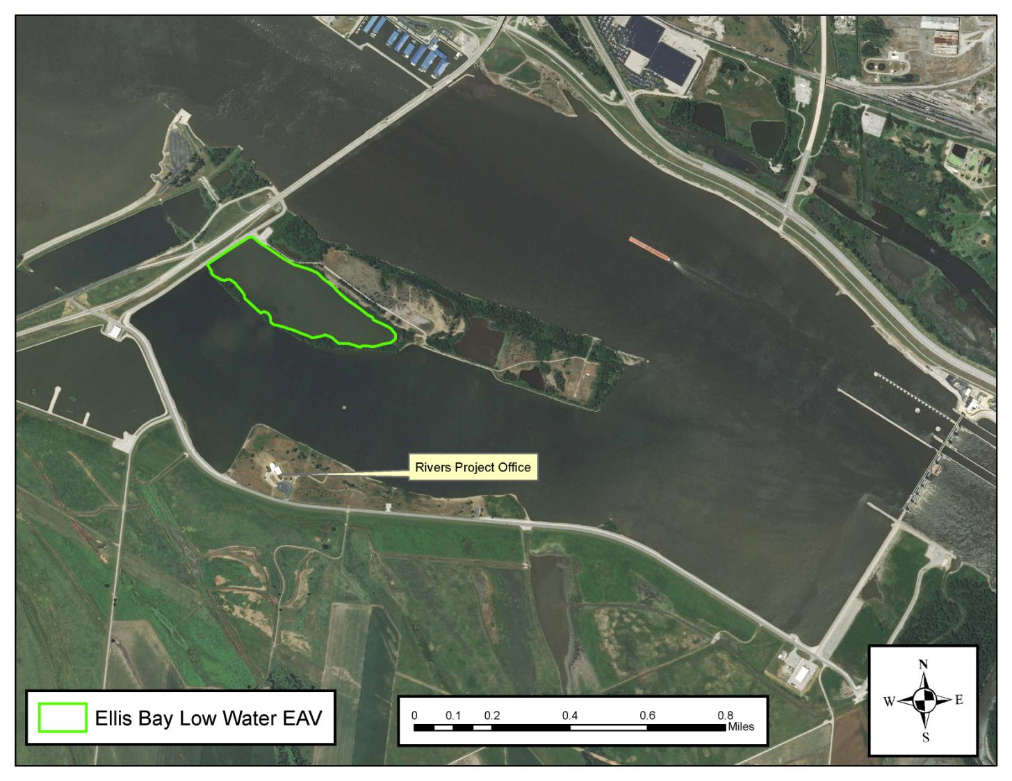

Slide 40
Carex sp.

Slide 41
Carex sp.

Slide 42
Polygonam sp.

Slide 43
Echinochloa crus-galli

Slide 44
Cyperus odoratus

Slide 45
Sagittaria latifolia

Slide 46
Leptochloa panicoides

Slide 48
View looking south

Slide 49
View from Hwy 367 frontage road

Slide 50
View from Hwy 367 frontage road

Slide 51
Emergent Aquatic Vegetation
Ellis Bay – Downstream near Mel Price Spillway

Slide 52
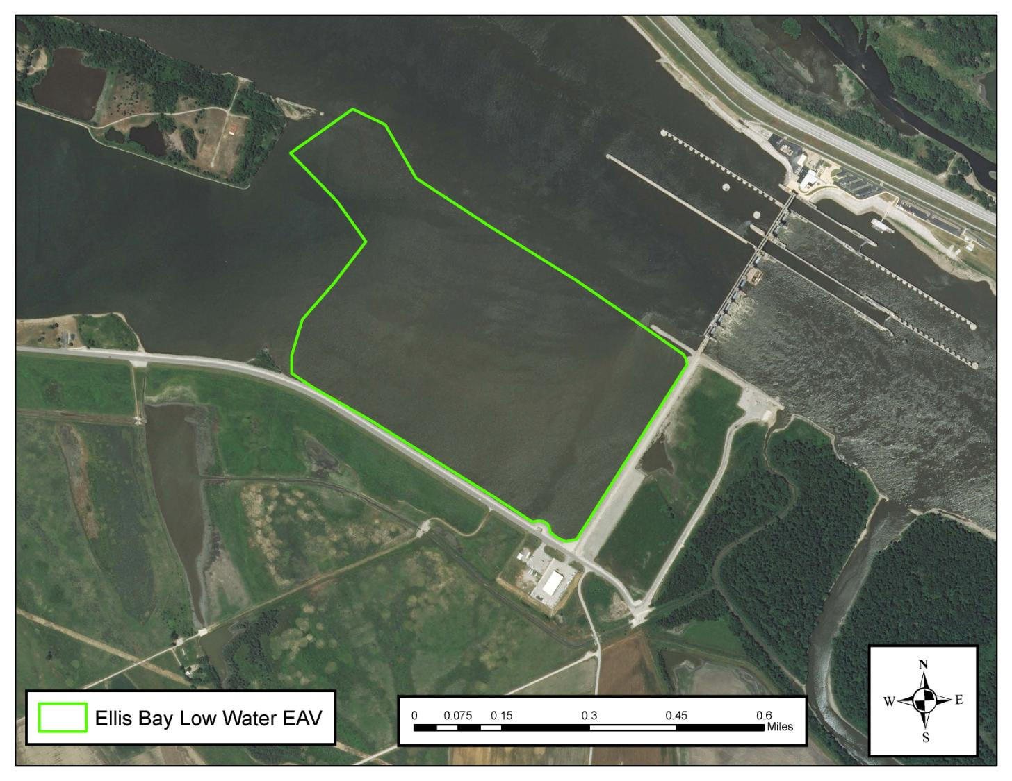

Slide 53
View from Mel Price Spillway

Slide 54
View from Mel Price Spillway

Slide 55
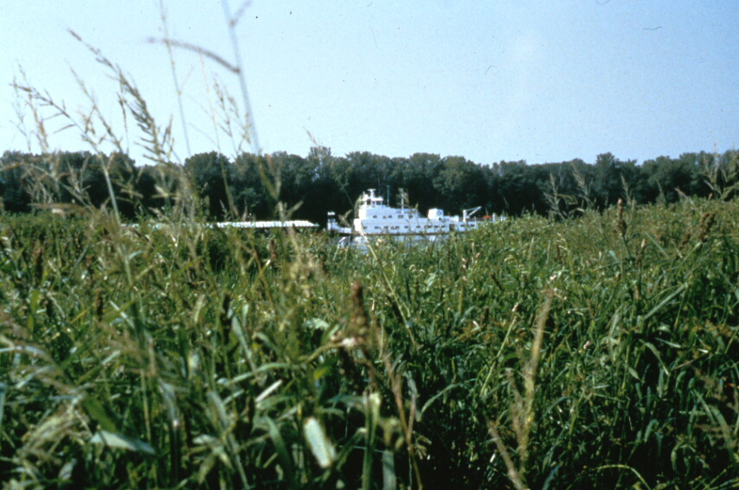
? ? ? Questions ? ? ?

