Slide 1
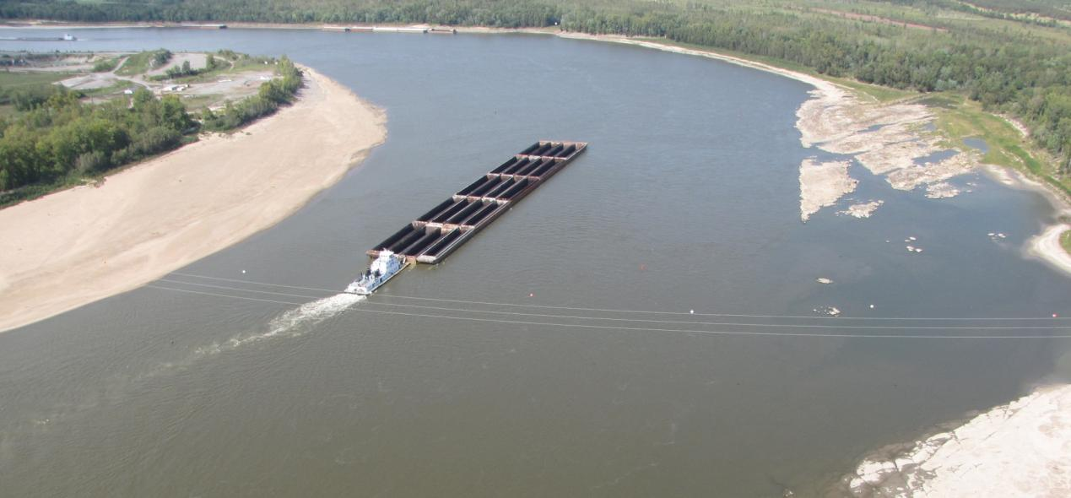
Rock Removal on the Middle Mississippi River
RRAT 2014

Slide 2
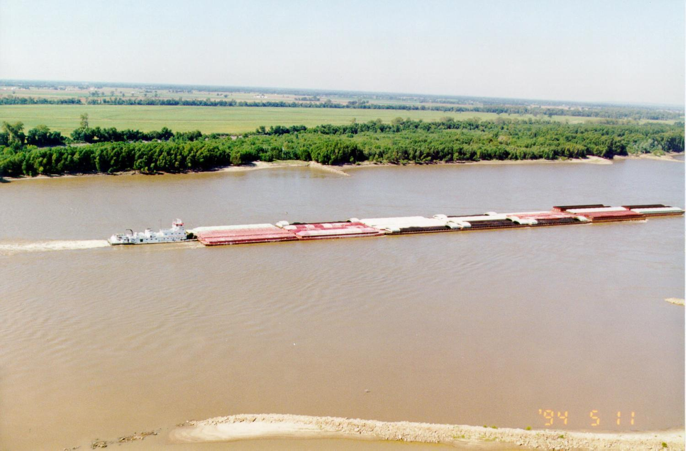
Navigation Channel Design
Develop a Reliable, Safe, and Environmentally Sustainable Navigation Channel on the Middle Mississippi River
1,500 feet long
9 feet deep
During low water periods required to maintain a 9 feet deep and a minimum of 300 feet wide navigation channel, with additional width in bends

Slide 3
Why is River Industry Important

Slide 4
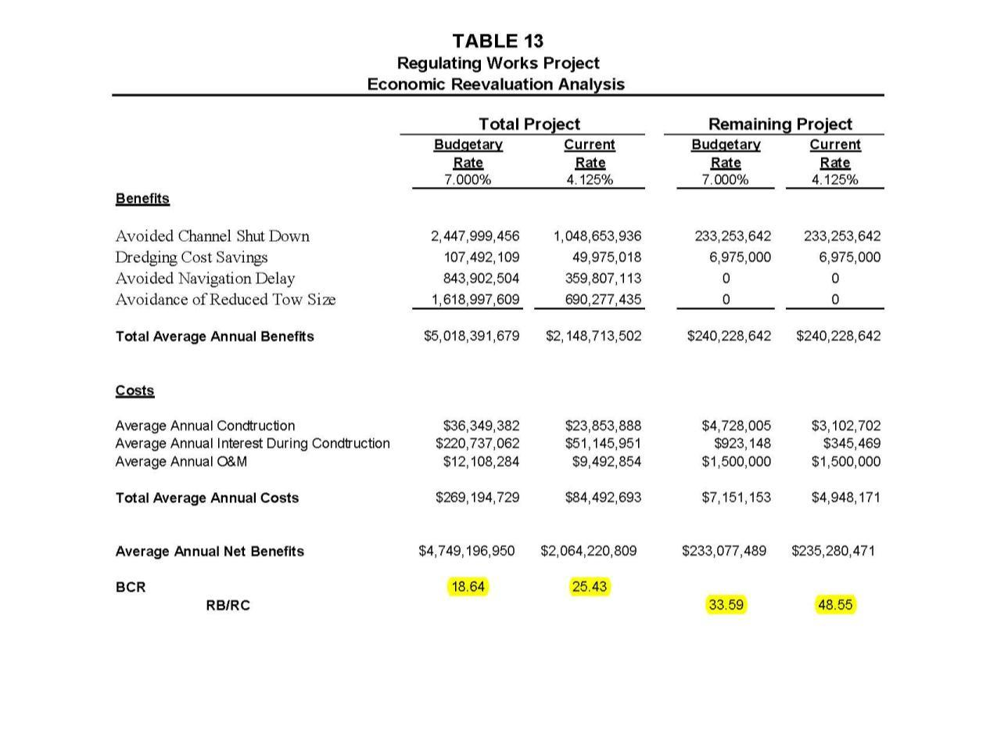
Regulating Works Project Benefits vs. Costs

Slide 5
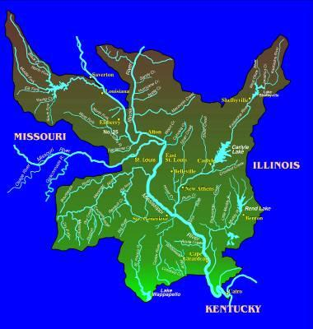
Pools vs Open River
MVS
Pools 300-195
Open River 195-0

Slide 6
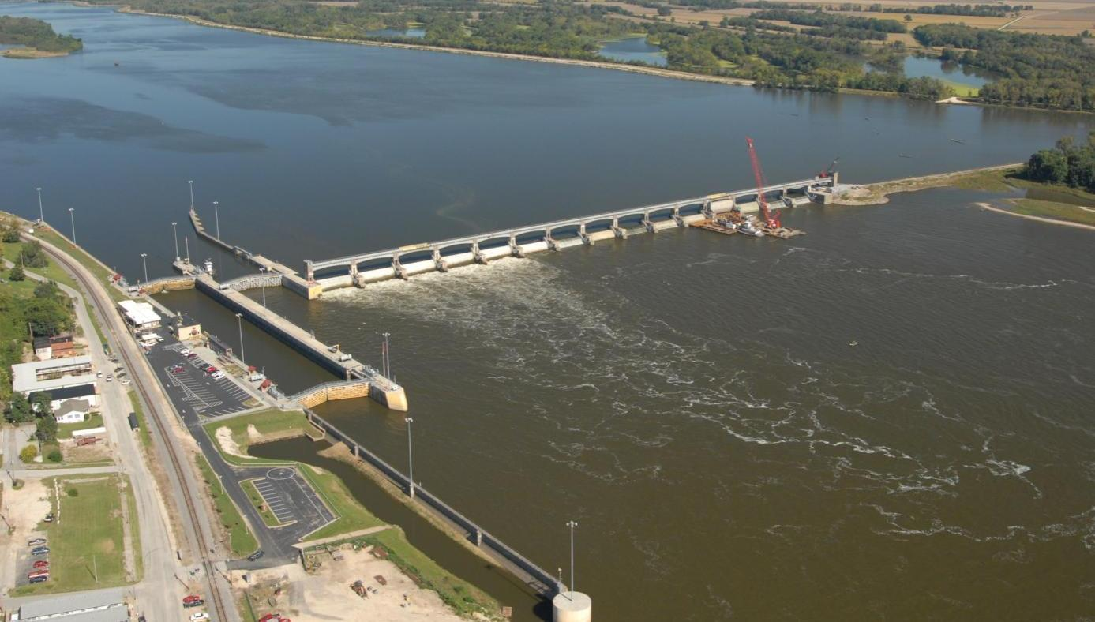
Lock & Dam #24, Clarksville, MO
Pools: Impounded Mississippi River
Upper River (RM 300-195)

Slide 7
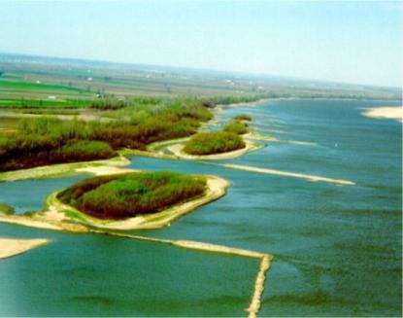
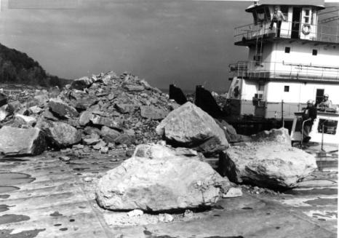
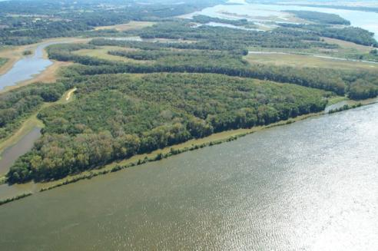
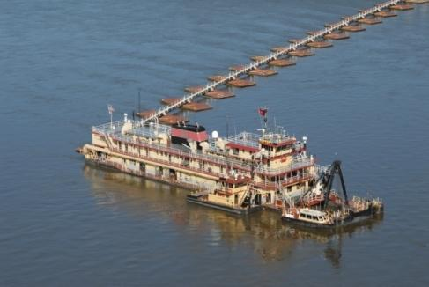
Tools To Maintain Navigation
(Open River RM 195-0)
Dikes and other Rock Structures
Rock Removal
Revetments
Weirs
Dredging

Slide 8
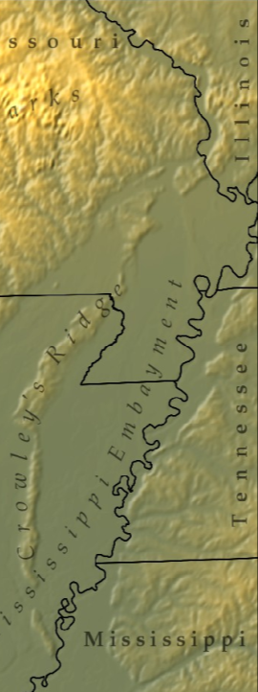
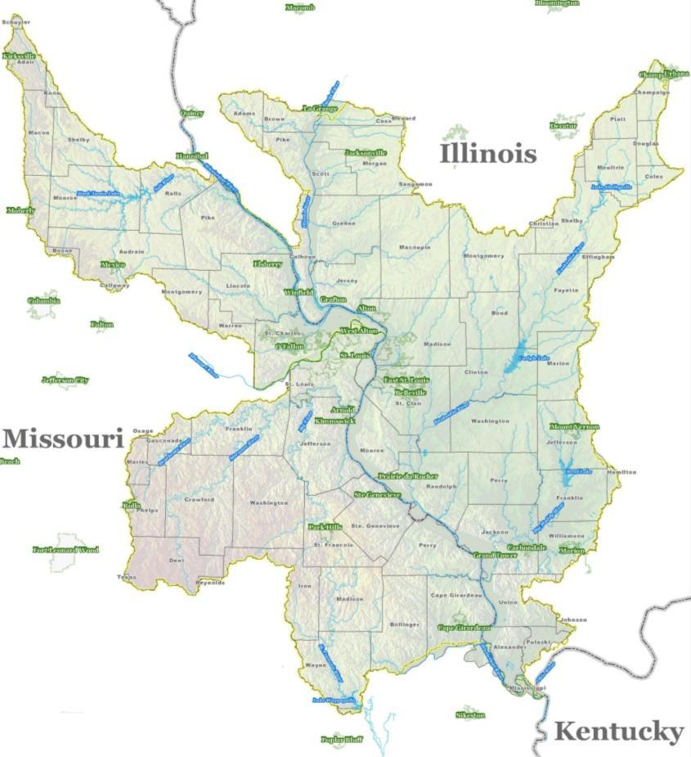
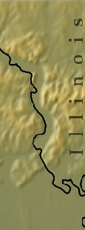
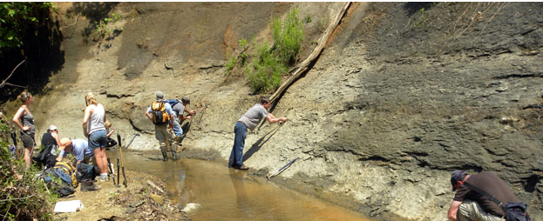
Rock Removal
What are we trying to remove?
MVS
N
Mississippi River
Grand Tower
Thebes
N
Notes:
Thebes was the Gulf
Hard dense limestone – 25,000 psi

Slide 9
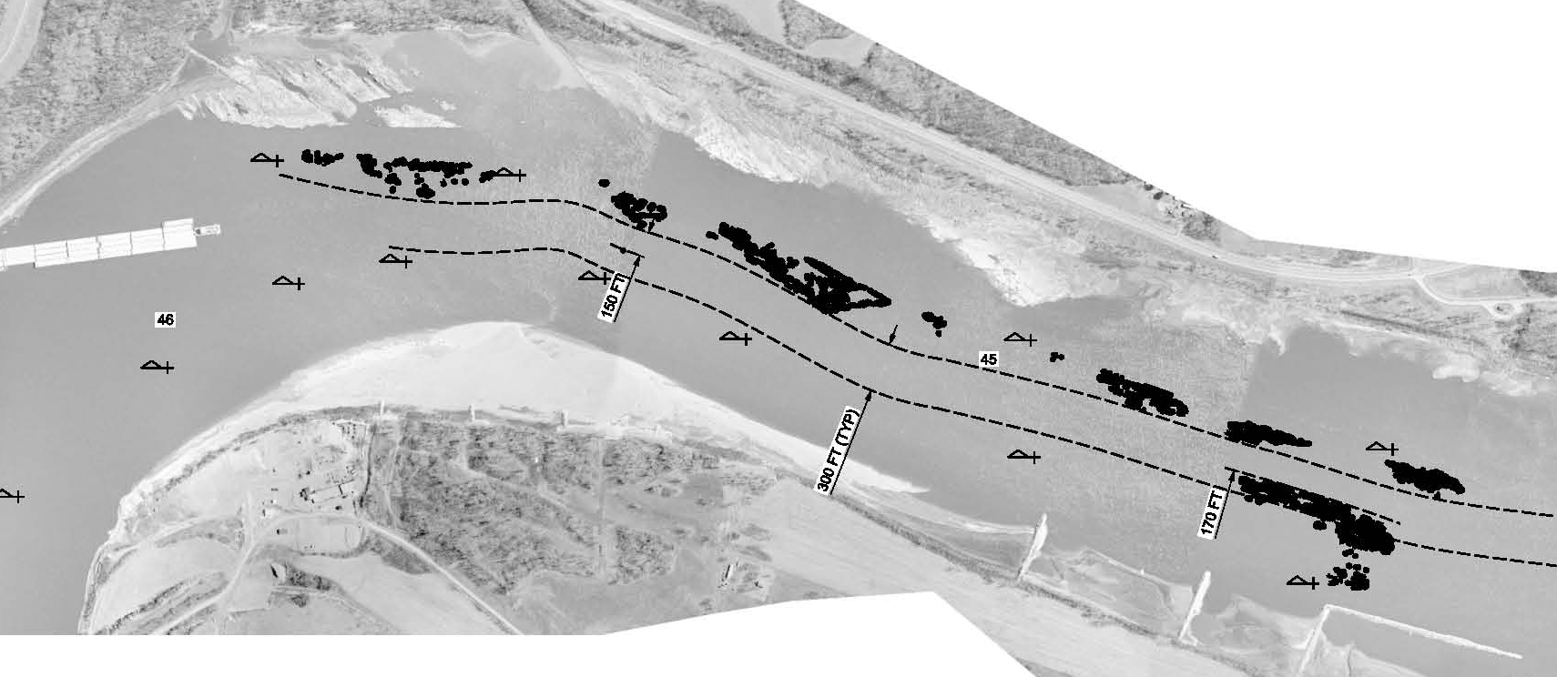
Problem Statement
Low Mississippi River stages will impact the St. Louis Districts’ ability to maintain the navigation channel at authorized project dimensions, in the Thebes Reach (RM 46-38) and Grand Tower Reach (RM 80-79), in the mid-December 2012.
Pinnacle Rock
Thebes Reach

Slide 10
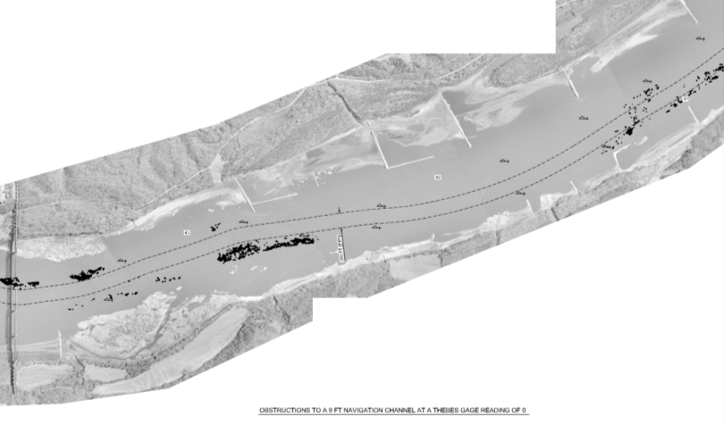
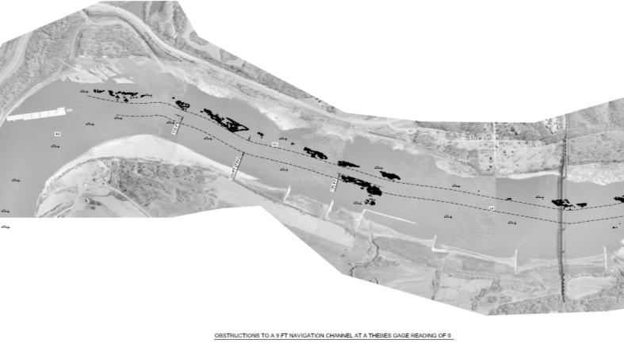
Phase 1 Engineering Analysis
Pinnacle Rock Impacts at Thebes Reach
St. Louis from -5.0 to -7.0
A-Minimum
C-Minimum
G-Unacceptable
F-Minimum
B-Unacceptable
D-Unacceptable
E-Minimum
Notes:
Collaborated with partners to prioritize removal locations
STL Gage (9’ depth) -4 to -5 questionable
STL Gage (9’ depth) -5 to -6 no channel

Slide 11
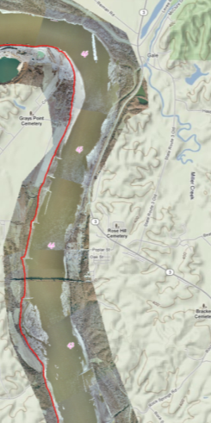
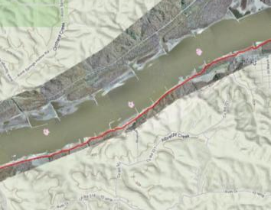
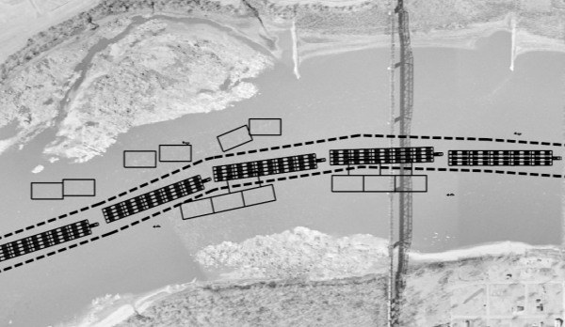
Rock Pinnacle Removal Phase 1
PHASE 1:
Accomplishes a 300 ft minimum channel in 4 locations that previously had insufficient width and depth.
The resultant channel can only support 15 barge tow. Larger tows must “double-trip” or break their tow apart and take individual pieces separately through the reach.
PHASE 1 MILESTONES
7 December 2012 – Decision made to go Urgent & Compelling
  Award 2 contracts based on sources sought query (Newt & Durocher)
7 December 2012 – Received verbal approval on Justification & Approval
7 December 2012 – Contract award. Letter contracts 50% ROM, Newt & Durocher
11 January 2013 – Minimum channel requirements achieved through Thebes Gage 0’ (approx -7’ STL Gage)
29 January 2013 – Contracts definitized to include modifications
27 February 2013 – Phase 1 Completed
1,000 cubic yards of material was removed at a cost of $8M
G
A
B
C
F
D
E
What Phase 1 Accomplished
This what a 20 barge tow may look like trying to navigate through a 300 ft wide channel. Notice that there is no room
for error considering the boxes along the channel border show additional phases of rock removal.
 | Acceptable Channel Condition for a 20 (4x5) Barge Tow (300+ ft wide channel)
 | Minimally Acceptable – at risk for a 20 (3x5) Barge Tow (300 ft maximum) channel or questionable channel width to flank through bend or for
 | alignment purposes.

Slide 12
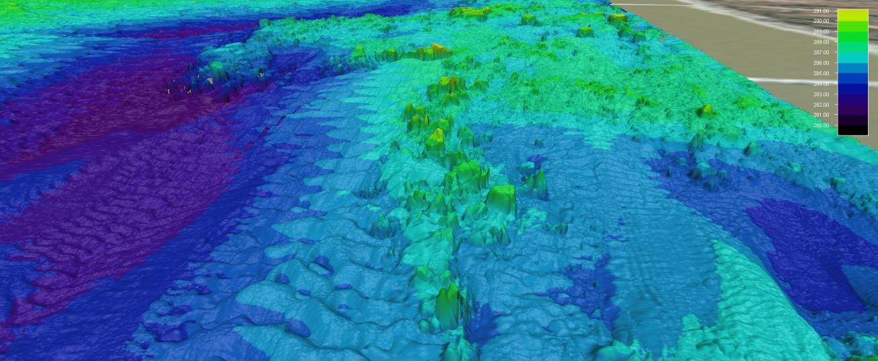
Rock Pinnacle Removal
Navigation Channel
Typical view of rock formation impacting
the navigation channel
DS View - Rock Pinnacles near River Mile 41, Thebes, IL
Notes:
Multi beam data sophisticated data collection
Phase 1 focused on U&C
Phase 2 will focus on the remaining width needed to provided a safe and dependable channel

Slide 13
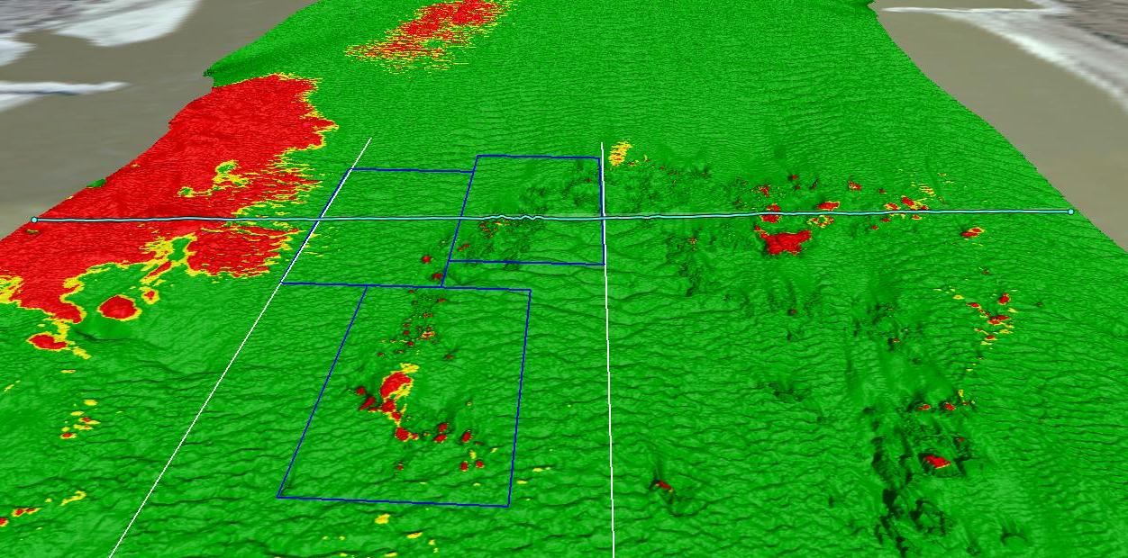
Rock Pinnacles at River Mile 38.5
Thebes Reach
Illinois
Missouri
300 ft Minimum Channel
Provided Cross Section
Phase 2 Rock Removal
Highest Pinnacle
Notes:
Phase 1 minimum channel requirements
Phase 2 safe and dependable
Industry needs 500’ width through these reaches

Slide 14
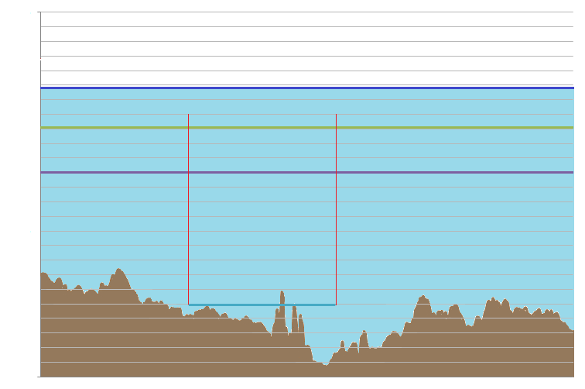

Cross Section at River Mile 38.5
Gage Reading (Depth after Removal)
8 Thebes (17 ft)
7 Thebes (16 ft)
Current Water Level
6 Thebes (15 ft)
5 Thebes (14 ft)
4 Thebes (13 ft)
3 Thebes (12 ft)
2 Thebes (11 ft)
1 Thebes (10 ft)
Water Depth at 0 Thebes (9 ft Channel After Removal)
0 Thebes (9 ft)
-1 Thebes (8 ft)
-2 Thebes (7 ft)
Low Water Channel
-3 Thebes (6 ft)
-4 Thebes (5 ft)
-5 Thebes (4 ft)
-6 Thebes (3 ft)
-7 Thebes (2 ft)
-8 Thebes (1 ft)
Removal Elevation
-9 Thebes (0 ft)
River Bed
Rock Pinnacles
Geometry of a cross section at RM 38.5 (Not to Scale)
Water Depth at 1-29-13 0800 was 5.8 ft at Thebes
Notes:
Remnant material for previous removal efforts

Slide 15
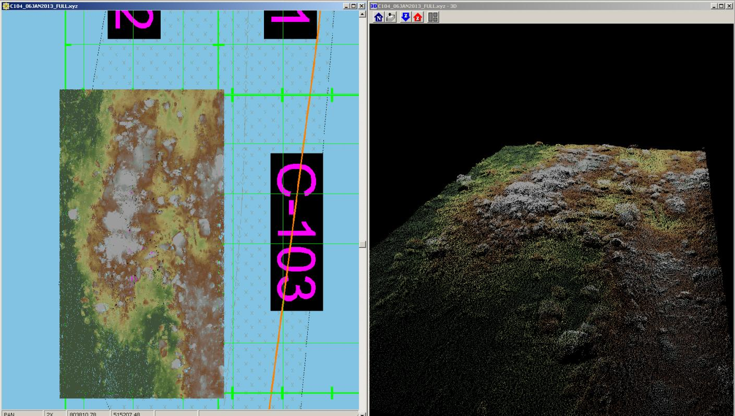
Rock Removal Surveys

Slide 16
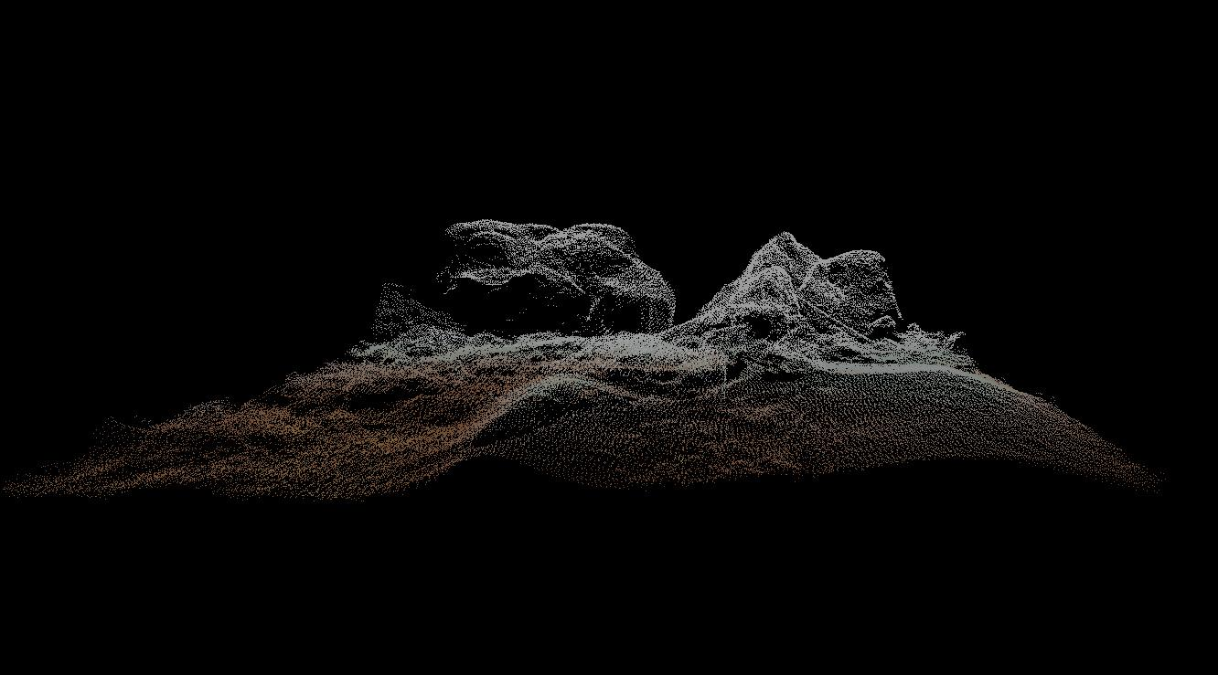
Rock Removal Surveys

Slide 17
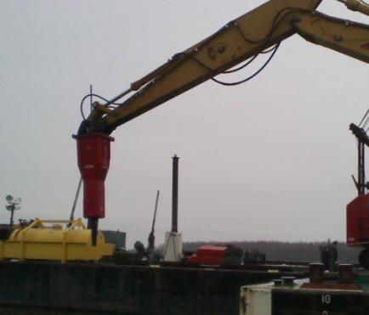
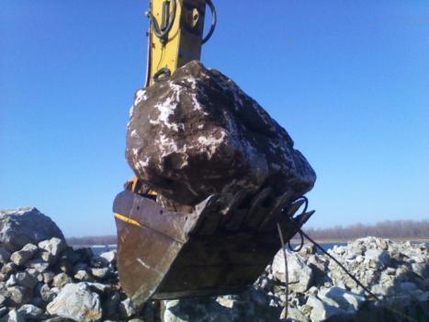
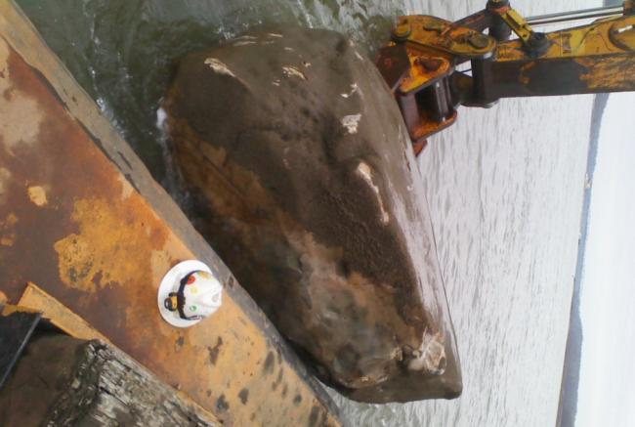
Rock Removal Methodologies
Environmental Assessment required us to “minimize the impact of the environment”
16,000 lb hydro-hammer
Notes:
Biological monitoring a key component, to date we have had a 0 take.

Slide 18
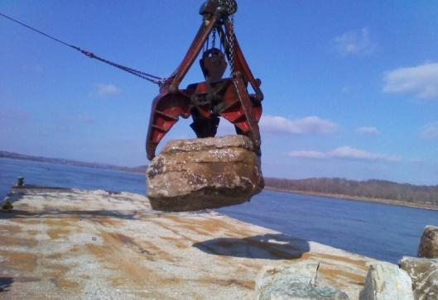
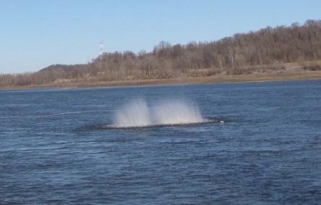
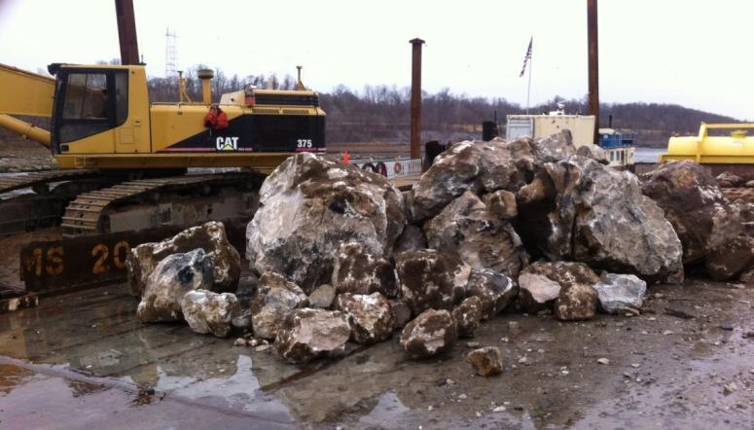
Rock Removal Methodologies
4.5 ton Grapple
Drill & Blast

Slide 19
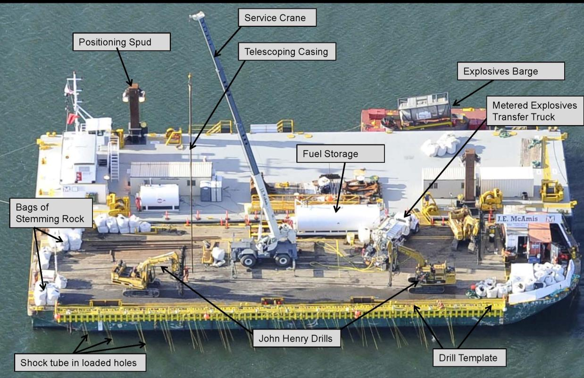
Rock Removal - Drill and Blast Method
Courtesy of NWP

Slide 20
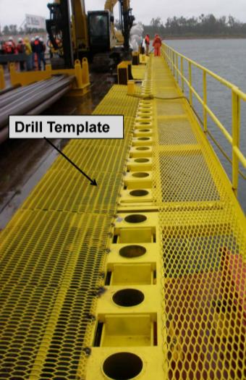
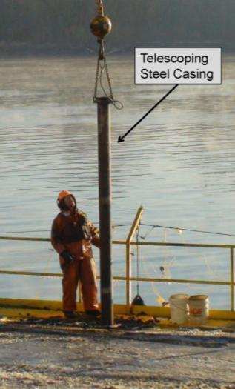
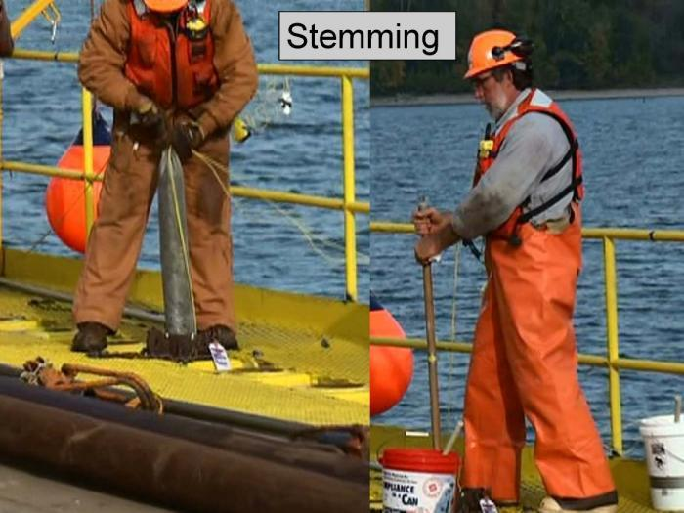
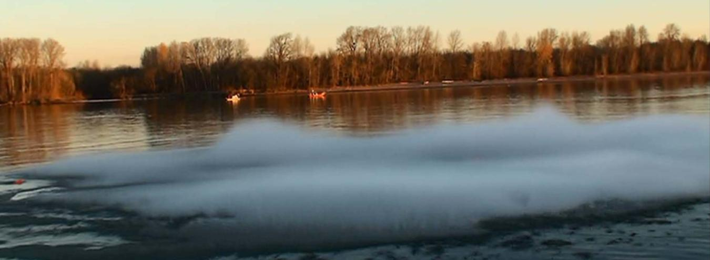
Rock Removal - Drill and Blast Method
Courtesy of NWP

Slide 21
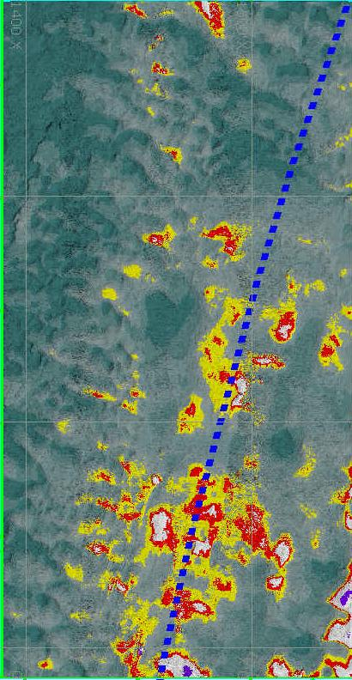
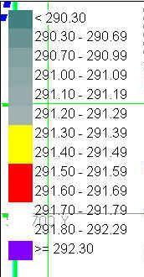
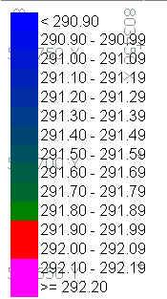
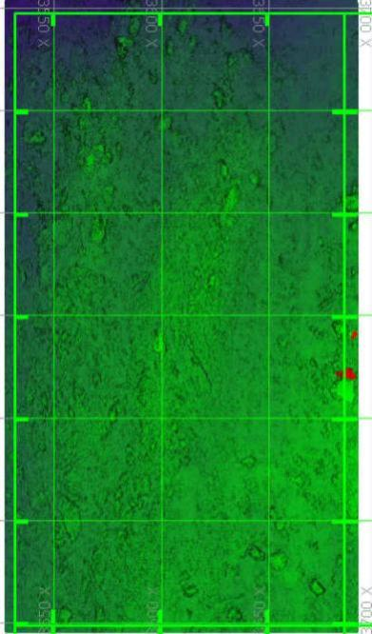
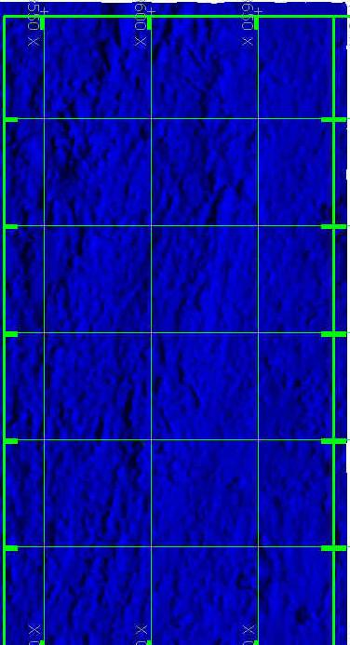
Rock Removal QA/QC
Notes:
Complex problem, siltation occurs almost immediately after location cleared
Cannot give our surveyors, engineers, and construction reps enough praise

Slide 22
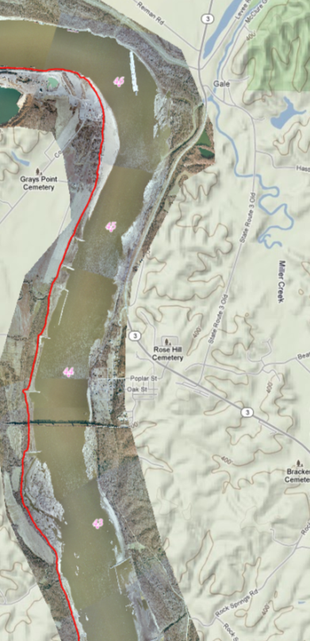
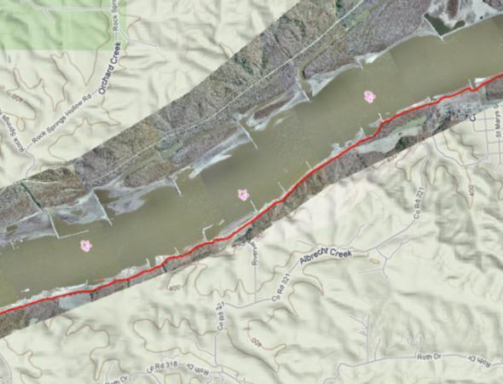
Rock Removal Phase 2 Base FY14
B
C
D
E
2 July – Awarded Rock Removal Phase 2 to Massman Construction for contract minimum of $1M
Includes a base and 3 option years, total contract amount$19M to remove 6,300 cy
NTP given on 27 November.
Massman on site 7 December with removal beginning on 11 December.
Locations have been prioritized to minimize the impacts to navigation during the months of December and January .
To date approximately 750 cy of material has been removed, 50% of the base contract.
Notes:
Achieved minimal channel requirements ahead of schedule
Coordination with contractors
Removal re-prioritization – USACE adapted to project requirements
Project funded within our existing program, currently have a $600k shortfall

Slide 23
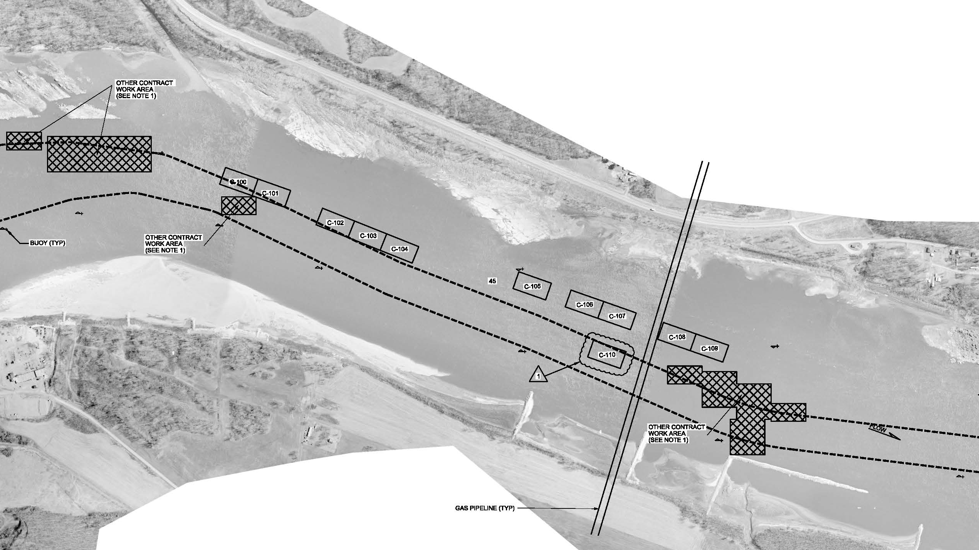
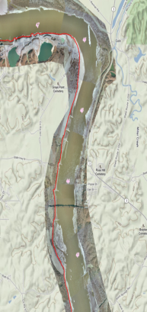
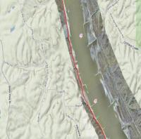
Rock Removal Phase 2 Thebes
River Miles 46-43
Massman Construction
A
B
C
B
D
Minimum 300 feet Navigation Channel
C
E
F
D
G

Slide 24
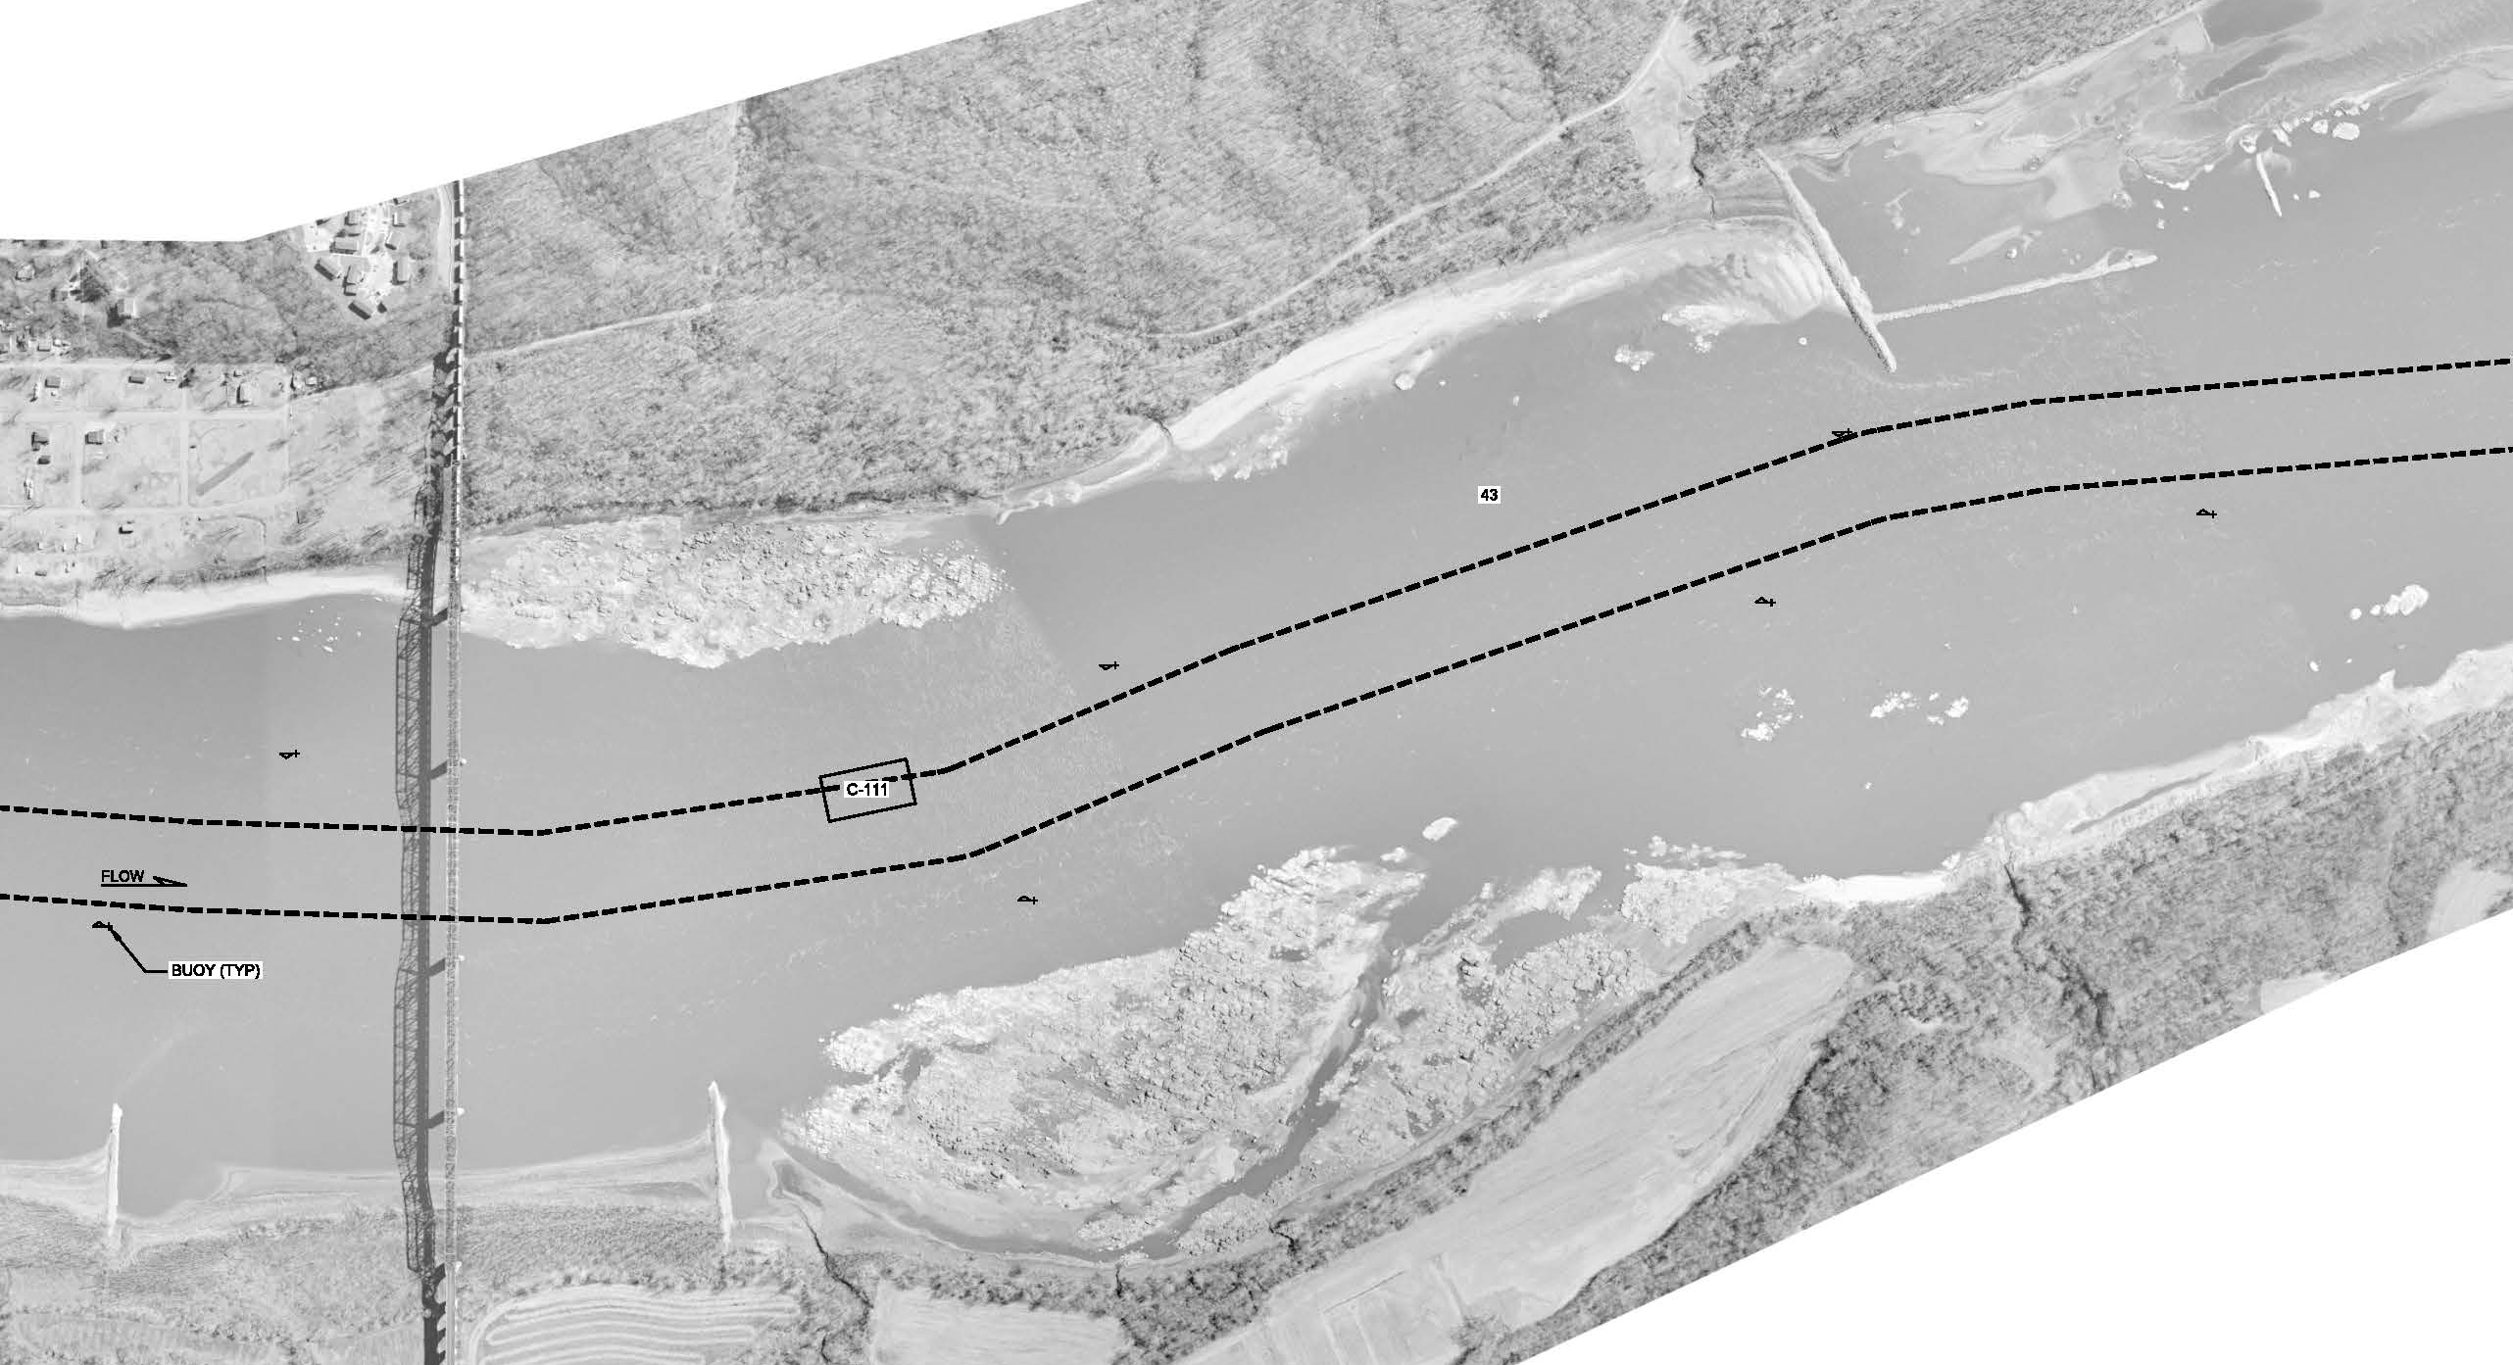
Rock Removal Phase 2 Thebes
River Miles 46-43
Massman Construction
A
B
C
D
Minimum 300 feet Navigation Channel
E
F
E
G

Slide 25
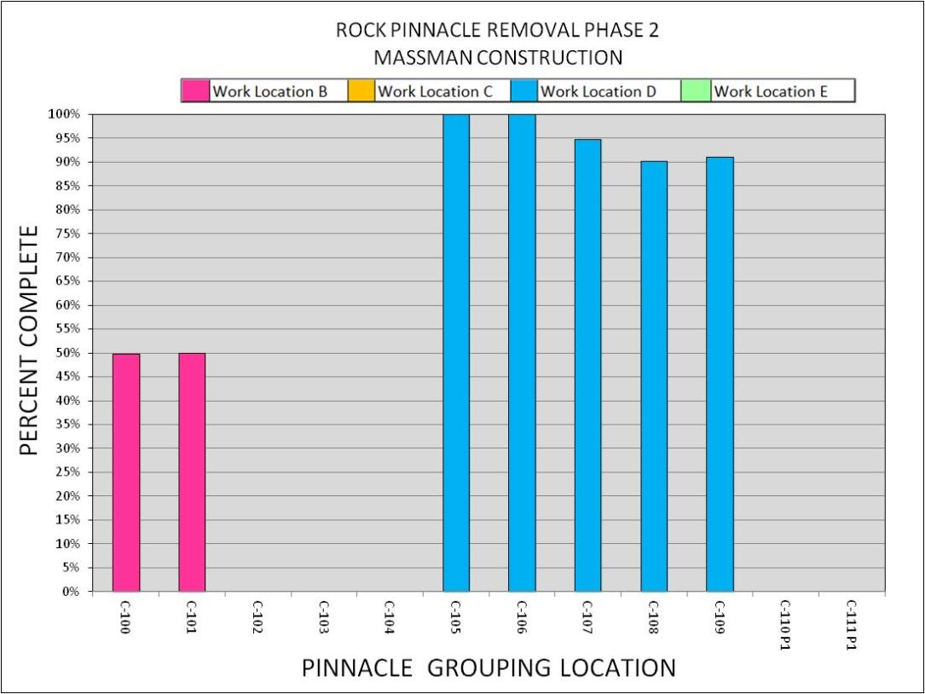
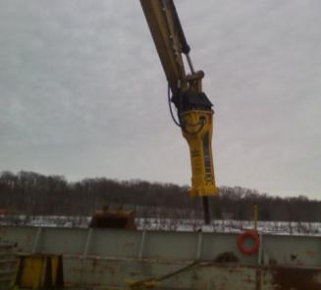
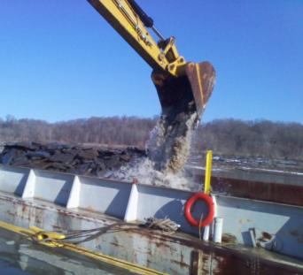
Sites B, C, D, E Thebes
River Miles 46-43
Massman Construction Update (As of 2-27-2014)
Hydro Hammer at C-106
Excavation at C-106

Slide 26
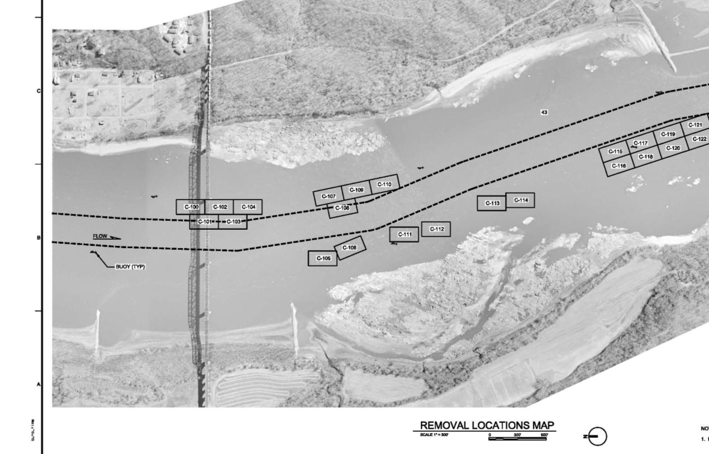

Rock Removal Phase 2 Option 1 Thebes
River Miles 44-42
Massman Construction
A
B
C
Minimum 300 feet Navigation Channel
D
E
E
F
G

Slide 27

Rock Removal Phase 2 Option 1 Thebes
River Miles 44-42
Massman Construction
A
B
C
Minimum 300 feet Navigation Channel
F
D
E
F
G

Slide 28

Rock Removal Stage Requirement

Slide 29

Rock Removal at RM 44.8

Slide 30

Rock Removal at RM 44.8
June 2006 Survey

Slide 31

Rock Removal at RM 44.8
October 2012 Survey

Slide 32

Rock Removal at RM 44.8
February 2013 Survey

Slide 33

Reporting Incorrect Information

Slide 34
Cross Section at River Mile 38.5
Gage Reading (Depth after Removal)
8 Thebes (17 ft)
7 Thebes (16 ft)
Current Water Level
6 Thebes (15 ft)
5 Thebes (14 ft)
4 Thebes (13 ft)
3 Thebes (12 ft)
2 Thebes (11 ft)
1 Thebes (10 ft)
Water Depth at 0 Thebes (9 ft Channel After Removal)
0 Thebes (9 ft)
-1 Thebes (8 ft)
-2 Thebes (7 ft)
Low Water Channel
-3 Thebes (6 ft)
-4 Thebes (5 ft)
-5 Thebes (4 ft)
-6 Thebes (3 ft)
-7 Thebes (2 ft)
-8 Thebes (1 ft)
Removal Elevation
-9 Thebes (0 ft)
River Bed
Rock Pinnacles
Geometry of a cross section at RM 38.5 (Not to Scale)
Water Depth at 1-29-13 0800 was 5.8 ft at Thebes
Notes:
Remnant material for previous removal efforts

Slide 35

Questions ?

