Slide 1
Engineering With Nature: Sustainable, Multi-benefit Projects
Thomas J Fredette, PhD
and Michelle Bourne Environmental Laboratory
Engineer Research and Development Center
Notes:
Focus at this conference is coastal, but also extends to other USACE business lines: Flood Risk Management, Hydropower, etc.

Slide 2
Outline
Engineering With Nature (EWN) background
Examples
Project database
Current demonstration projects
Path forward
Discussion

Slide 3
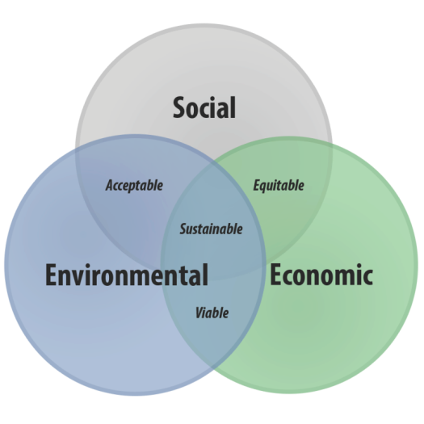
Engineering With Nature is…
…the intentional alignment of natural and engineering processes to efficiently and sustainably deliver economic, environmental and social benefits associated with water resources infrastructure through collaborative processes.
Key Ingredients:
Science and engineering that produces operational efficiencies
Using natural process to maximum benefit
Broaden and extend the benefits provided by projects
Science-based collaborative processes to organize and focus interests, stakeholders, and partners
www.engineeringwithnature.org

Slide 4
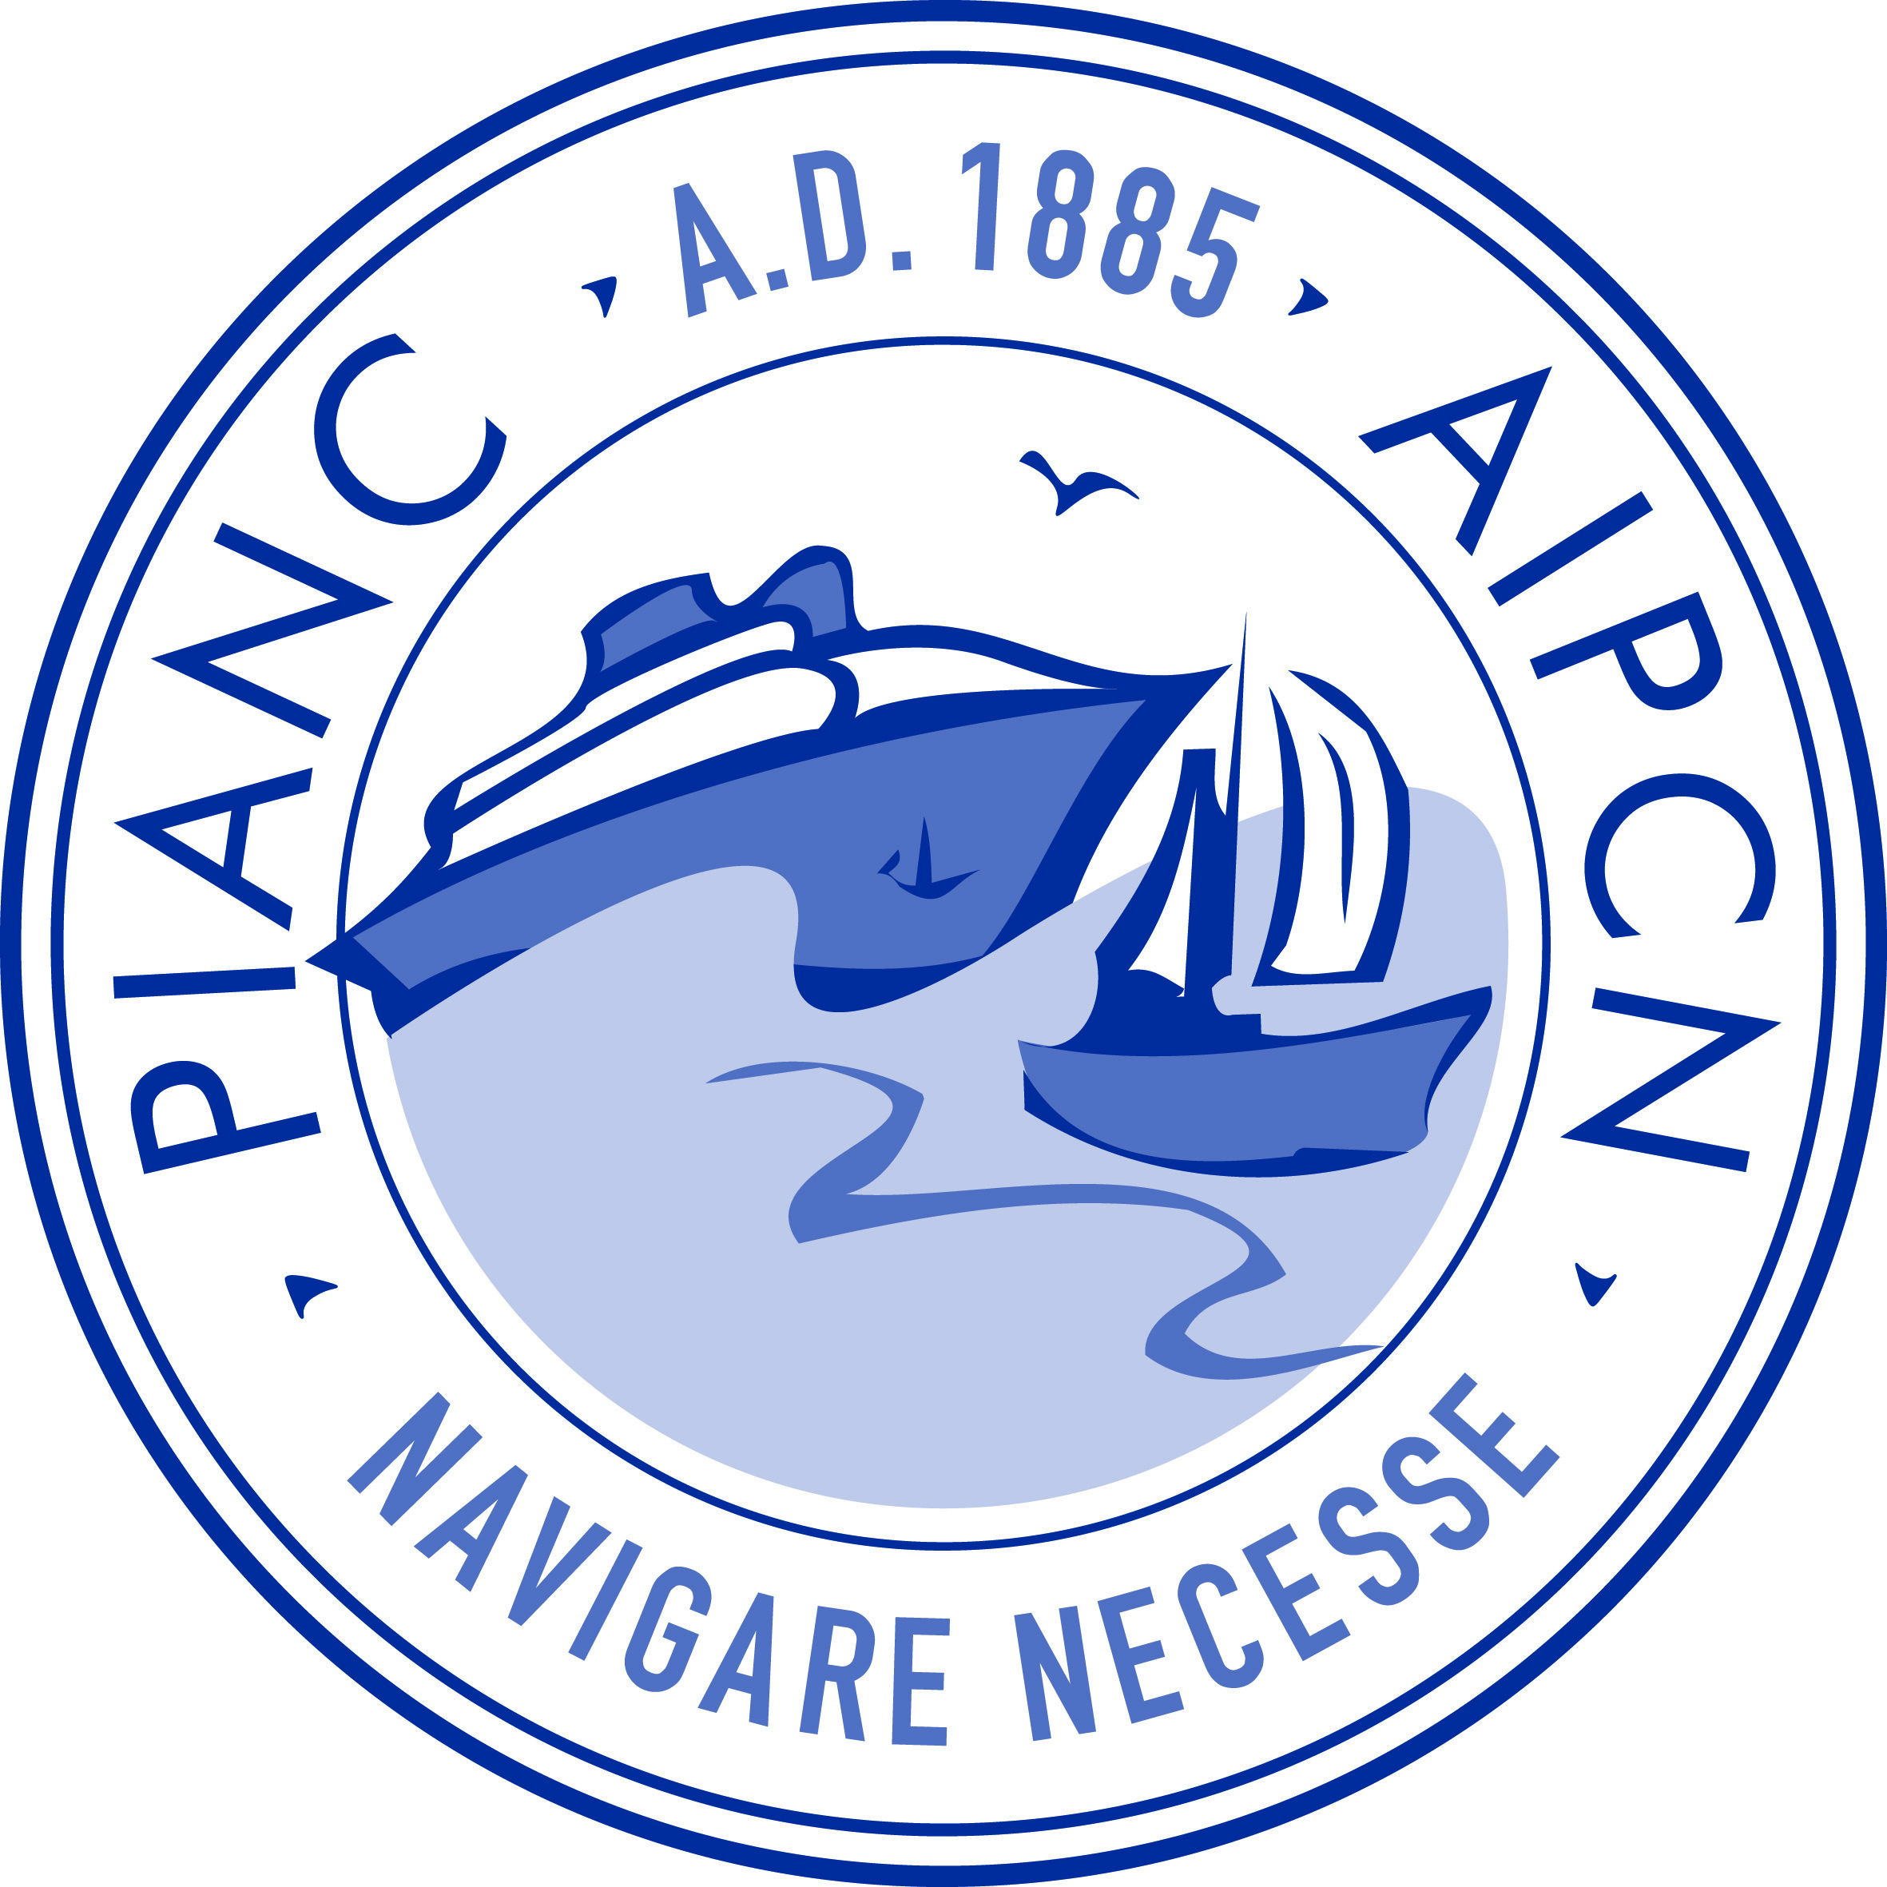
Working
with Nature
Building
with Nature
Engineering
With Nature

Slide 5
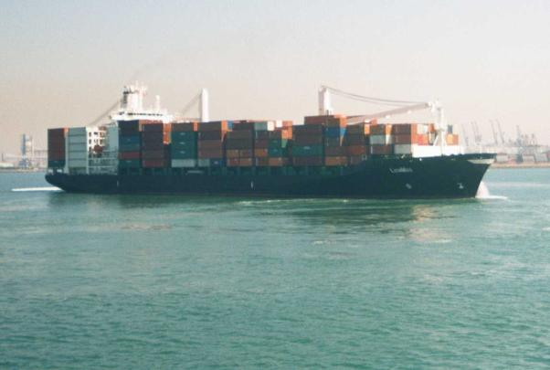
The USACE Navigation Mission
To provide safe, reliable, efficient, effective and environmentally sustainable waterborne transportation systems for movement of commerce, national security needs, and recreation

Slide 6
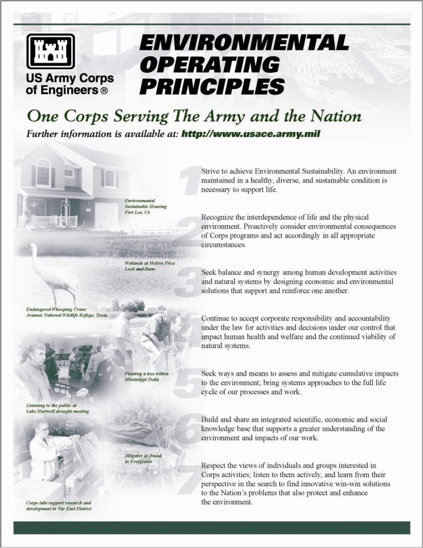
The USACE Environmental Operating Principles
Notes:
Have been around for over a decade and recently re-invigorated. Finding there way more and more into the culture.

Slide 7
Current Status
Engineering With Nature initiative was started by USACE Navigation program in 2010. Over that period we have:
Engaged across USACE Districts (23), Divisions, HQ; other agencies, NGOs, academia, private sector, international collaborators
•Workshops (>20), dialogue sessions, project development teams, etc
Broadening EWN to other Business Lines (FRM, RSM, Hydro).
►Implementing strategic plan
►Focused research projects on EWN
►Field demonstration projects
►Communication plan
►Awards
•2013 Chief of Engineers Environmental Award in Natural Resources Conservation
•2014 USACE National Award-Green Innovation

Slide 8
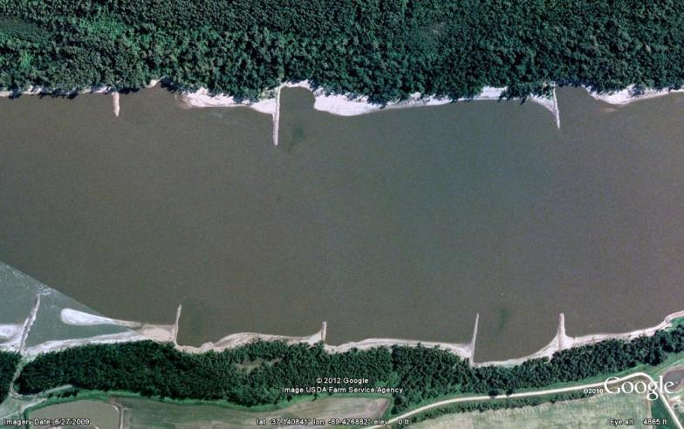
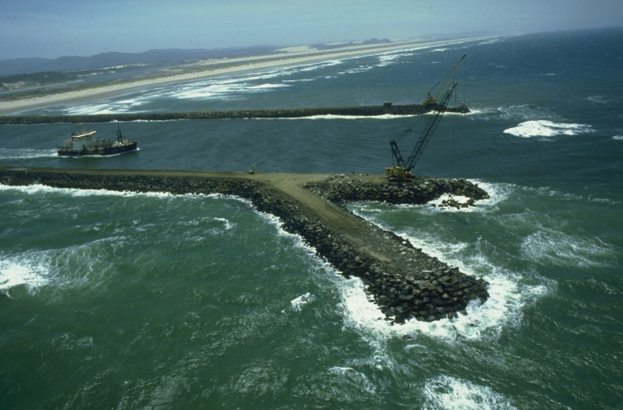
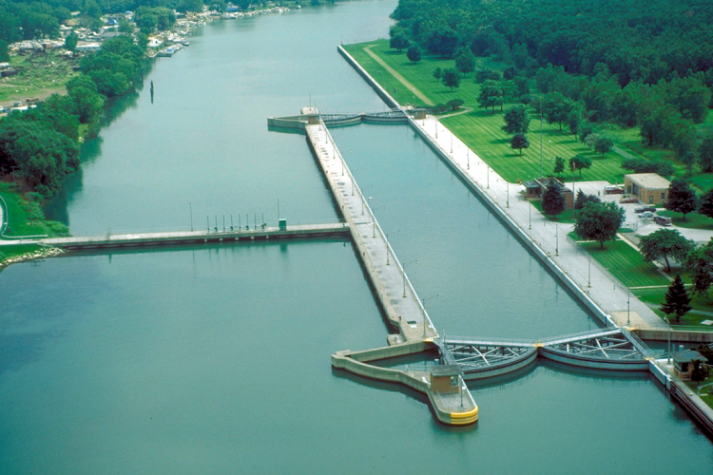
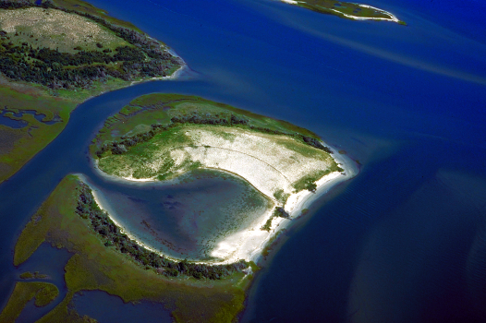
Opportunities/Existing Examples
Notes:
The USACE real property inventory contains approximately 1,000 coastal structures, 2,500 recreation areas, 75 hydropower facilities, 200 plus locks, 600 dams, and seven laboratories. USACE is responsible for operating and maintenance costs for approximately 25,000 miles of navigable federal channels and over 300 commercial harbors which are not federally owned and are not part of the USACE real property inventory.
https://cadbim.usace.army.mil/MyFiles/3/0/usace_amp.pdf

Slide 9
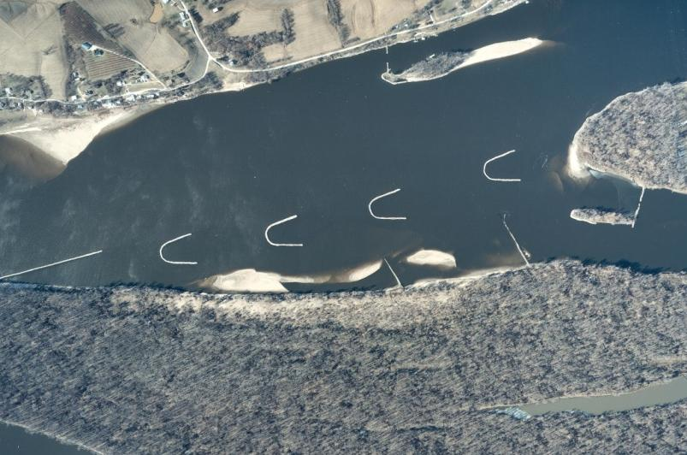
River Chevrons
Notes:
Chevron provides an excellent example of EWN principles. Why? Next few slides used to answer the question. Note scale – roads & houses

Slide 10
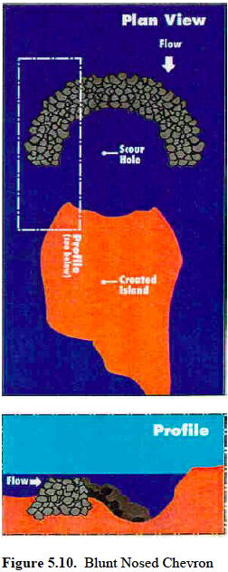
Notched Chevron River Flow and Sediment Bed Behavior Center section of chevron at lower elevation (e.g., notched)
Notes:
Design with notched noses further enhances the habitat diversity creating both deep pool and shallow emergent sand bars contributing to habitat needs for many key river species, both fish and birds.

Slide 11
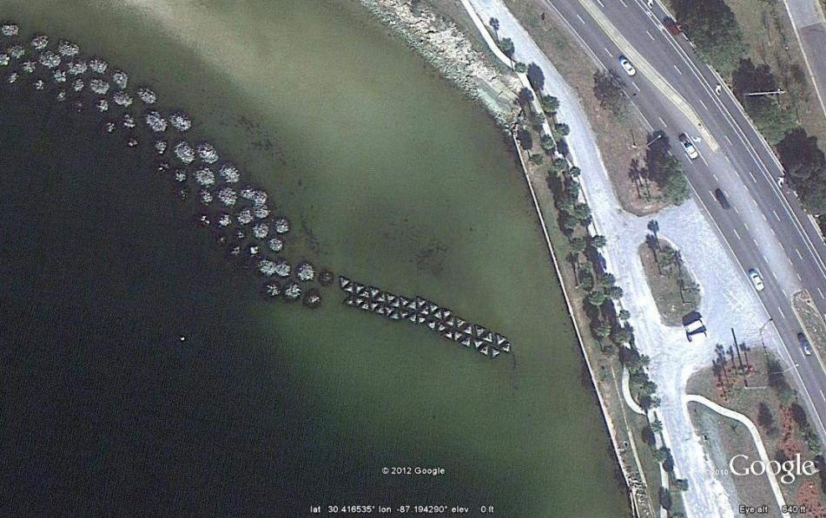
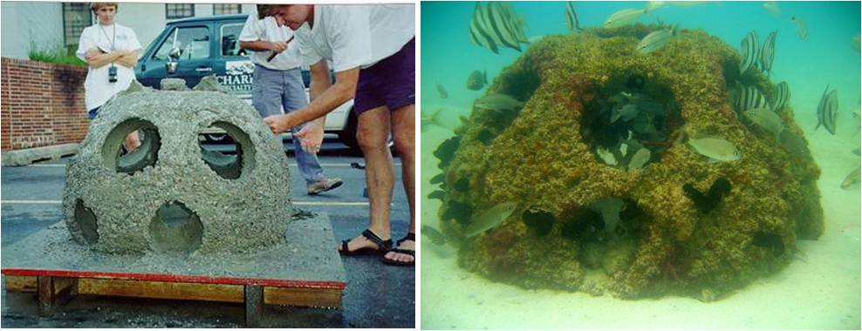
Reef Habitat Breakwaters, Pensacola, FL
Cobble Mounds
Notes:
Shore protection using reef habitat breakwaters – generally for low to moderate wave climates, modules size adjusted based on site needs, three or more rows to be effective, some monitoring to support success. Used rather than hardening shorelines. Keeps the ecological edge.

Slide 12
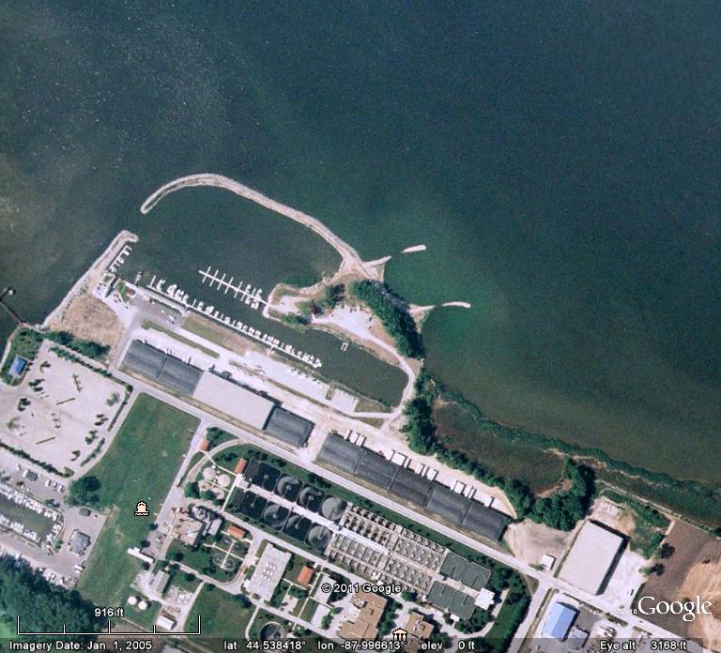
South Bay Marina
South Bay Marina, Green Bay, WI
Spur jetties to create marsh and protected shallows.
Fish spawning stones incorporated into design.
Spur Jetties
http://www.seagrant.wisc.edu/Home/Topics/HabitatsandEcosystems/Details.aspx?PostID=552
Notes:
Habitat features designed as part of marina construction to provide habitat types that were historically lost to development throughout the system.

Slide 13
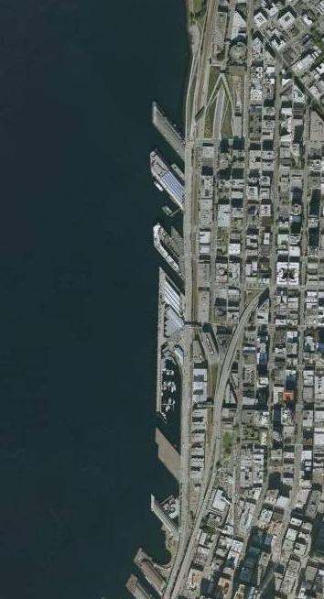
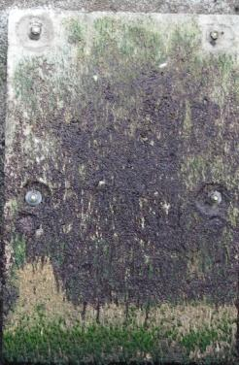
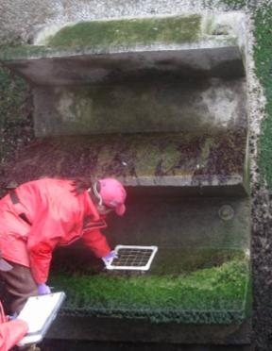
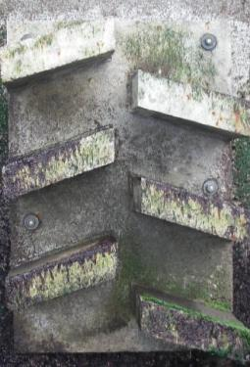
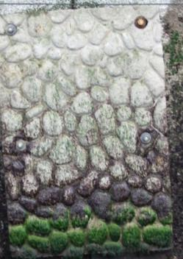
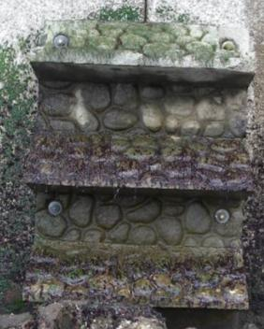
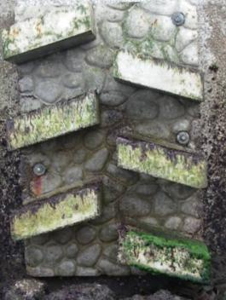
Seattle, WA Seawall Study
https://sites.google.com/a/uw.edu/seattle-seawall-project/home
3 panel designs, each with 2 surface treatments;
plus Reference and Control
3 Sites
Clay St.
Vine St.
Aquarium
Notes:
Seattle needs to rehabilitate a few 1000 meters of seawall and has studied different designs to help support needs of juvenile salmonids. Designs intended to provide both shelter and habitat for species that serve as food sources.

Slide 14
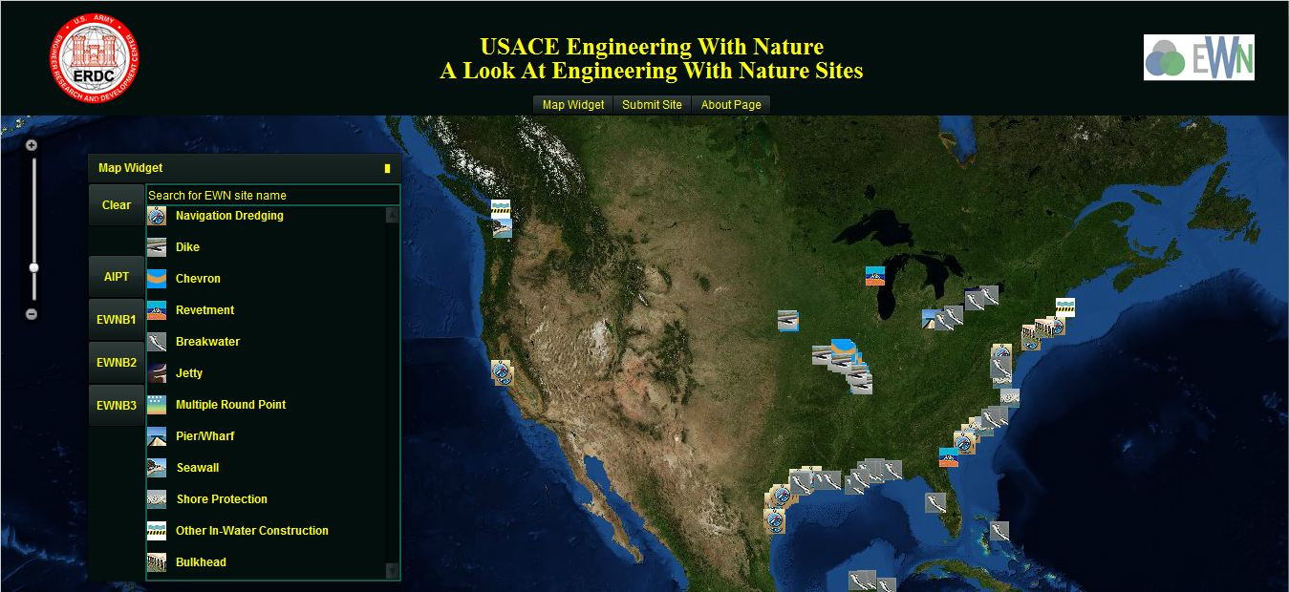
EWN ProMap (project mapper)
interactive on-line catalog of case studies that apply the EWN concept.
http://155.82.160.6/applications/opj/V013/public/viewer.swf
or from http://el.erdc.usace.army.mil/ewn/index.html

Slide 16
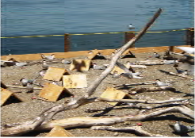
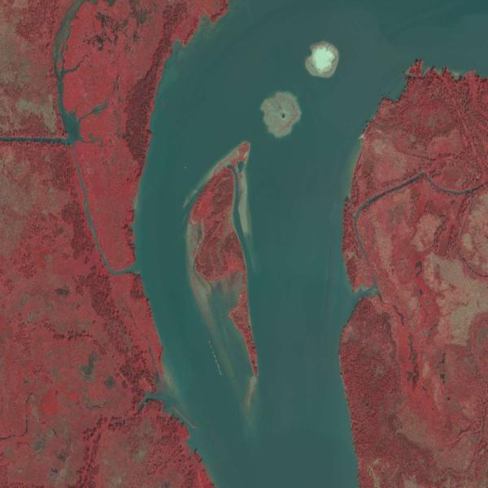
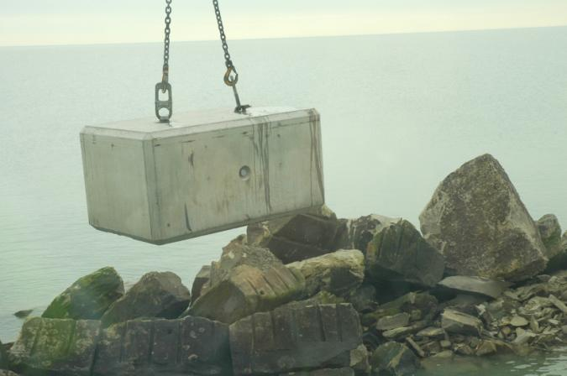
Current Demonstration Projects

Slide 17
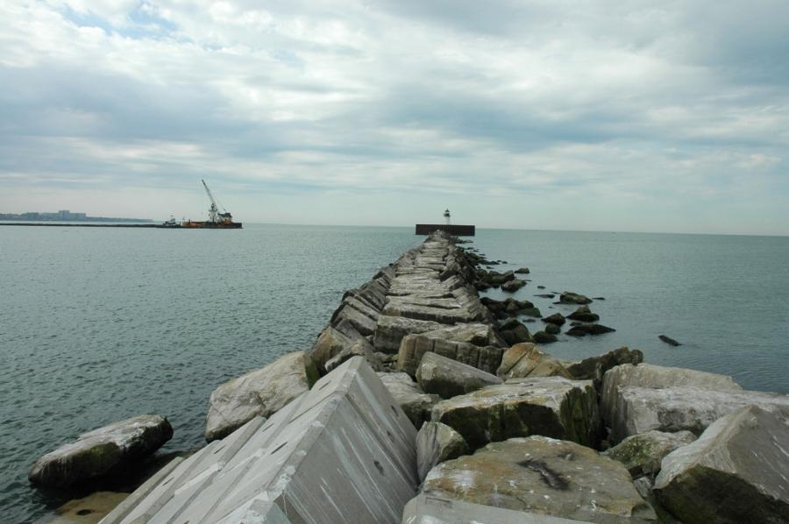
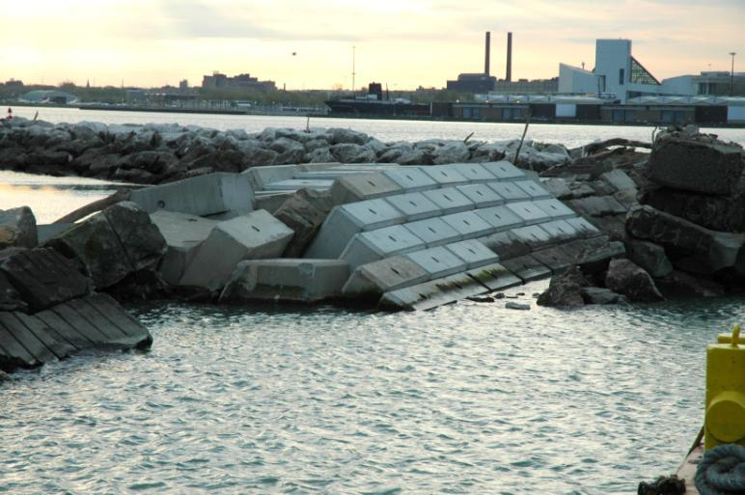
Deteriorating Breakwater
Short Repair Section w/ Block
8’ x 4’ x 4’ Repair Toe Block

Slide 18
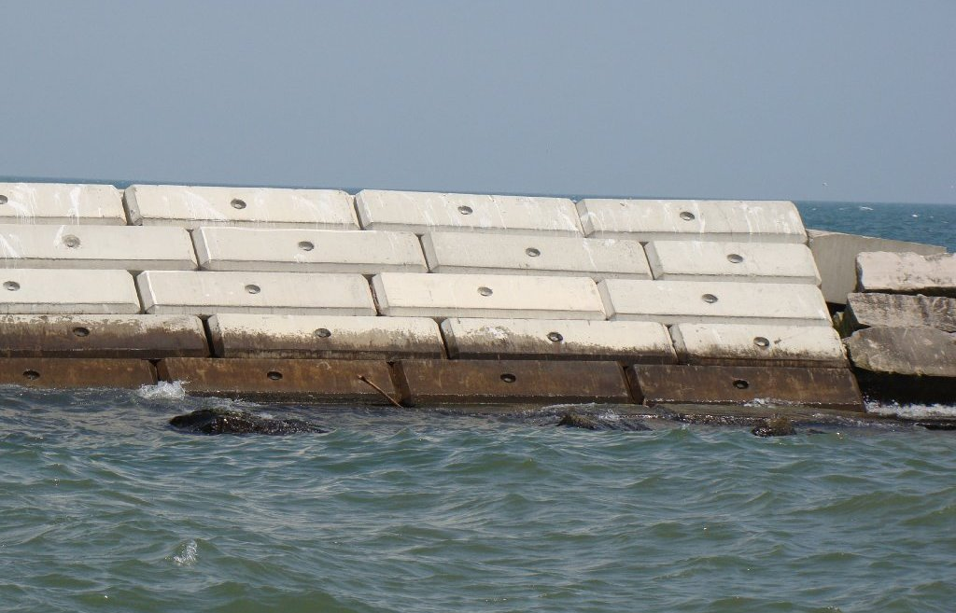
Are there ways to improve biological value of blocks?

Slide 19
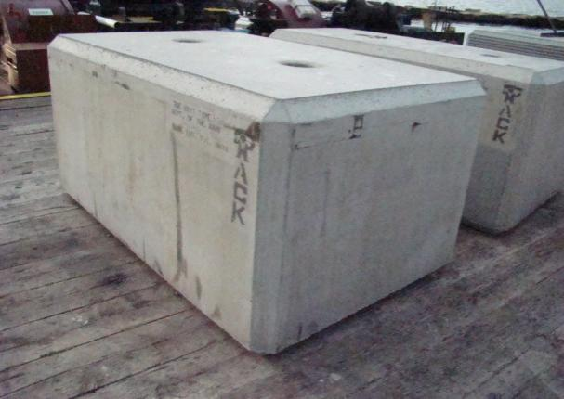
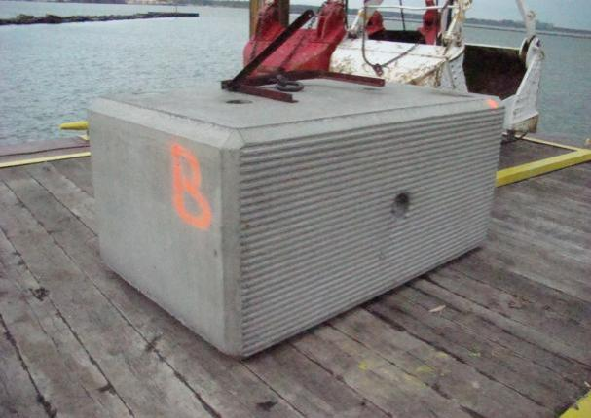
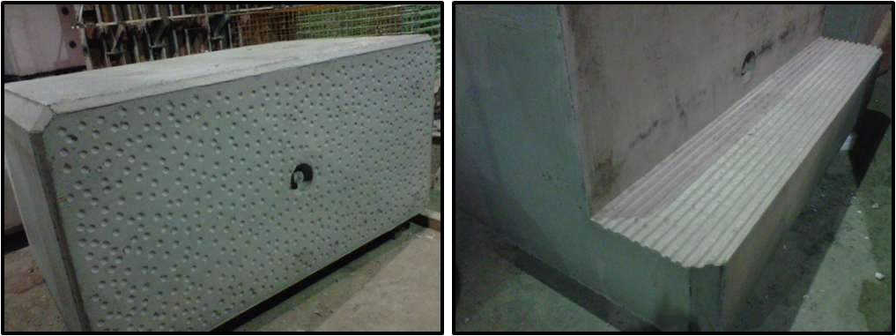
Cleveland & Ashtabula, OH
Control
Grooved
Dimpled
Grooved Shelf

Slide 20
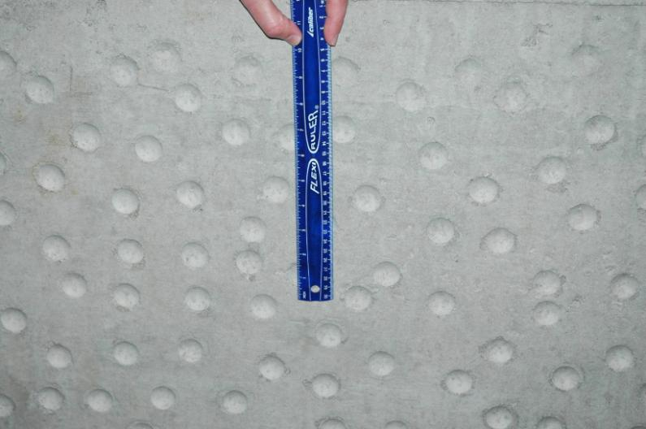
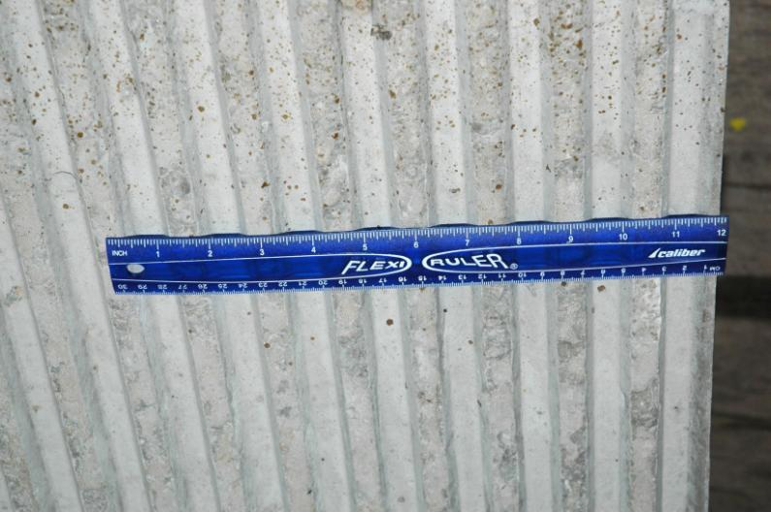
Texture Scale

Slide 21
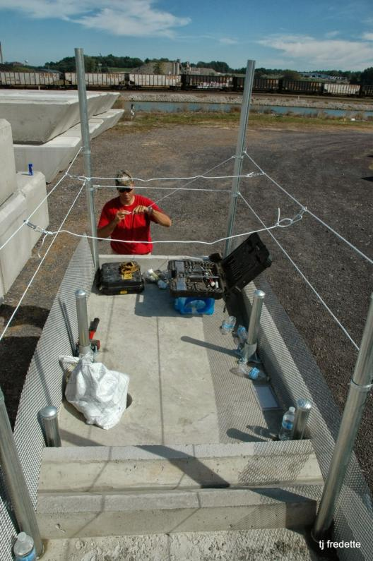
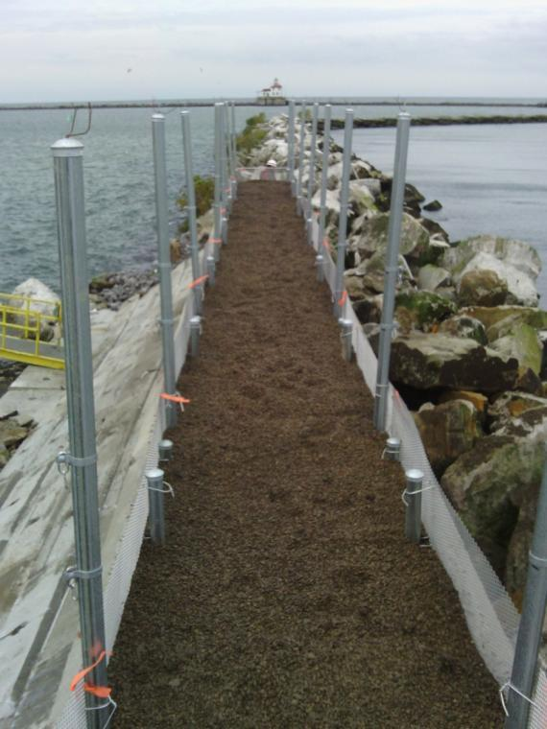
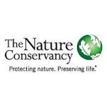
Ashtabula, OH Tern Nesting Blocks

Slide 22
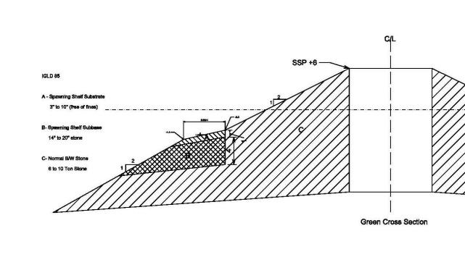
Milwaukee, WI Fish Spawning Shelf
500’ demonstration section
Spring 2014 construction
4-8” d Stone
8-18” d Stone
6-10 ton Stone
(60-72” d)

Slide 23
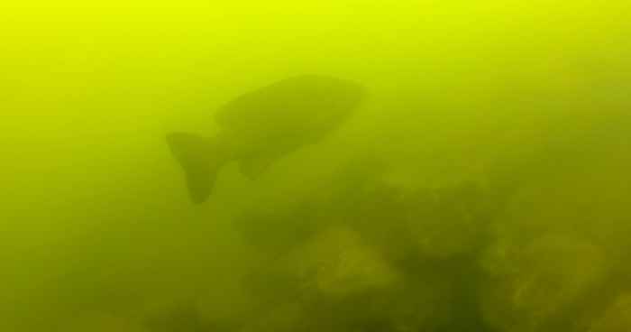
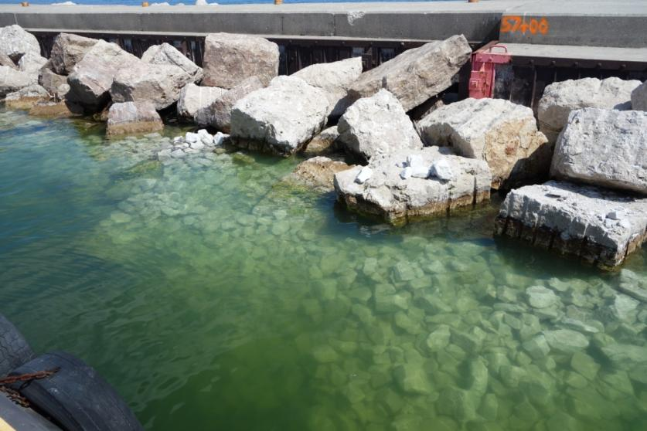
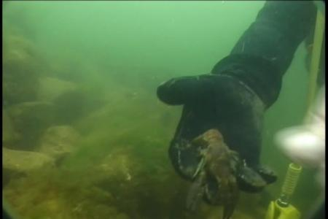
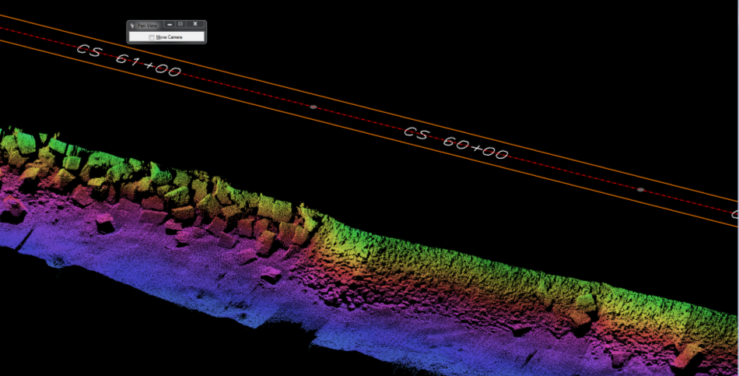
Post Construction Monitoring
Side-scan Sonar
Notes:
Multi-beam screen clip from 9 April 2014 survey. Spawning bed begins at about 60+00 per arrow.
Next steps are to monitor the beds for use by fish species, led by local academic partner.

Slide 24
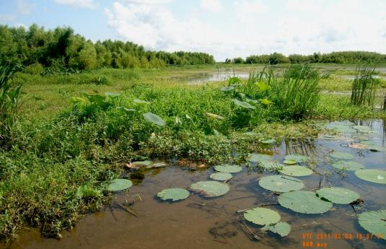
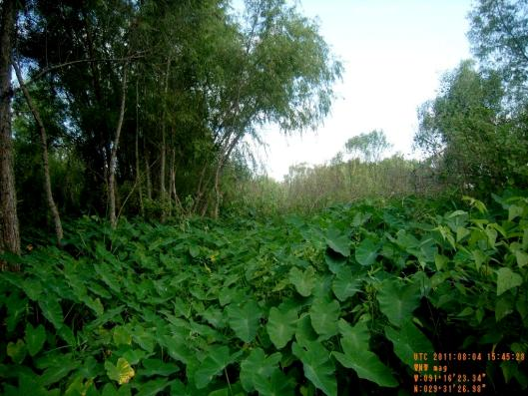
Horseshoe Bend Island
Atchafalaya River, LA
Atchafalaya River
Dredged Material Feeder Mounds
A
A
B
B
90-Acre Island Formed from & Shaped by Dredged Material
C
C
Notes:
Island in Atchafalaya River formed thru beneficial use of dredged material. Dredged material is placed upstream of a natural sandbar, allowing river currents to carry dredged material into and nourish the sandbar. After 2 or 3 placement events, the sandbar transformed into an island; after 7 placement events, the island is now about 90-acres. The island contains unique habitats because of this “Engineering with Nature”. Higher elevation areas resemble prairies (A), interior pools have formed shallow open-water habitat (B), and mature stands of trees formed along oldest area (C). The center even features a 15-acre stand of lotus.

Slide 25
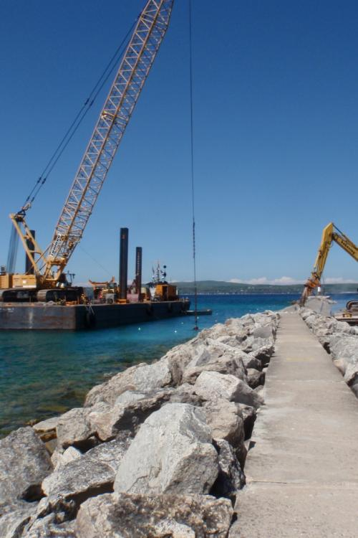
Engineering With Nature Path Forward
Integrate more fully into organizational culture
Communicate goals with partners, academia, & public
Seek opportunities to conduct demonstrations or full scale projects with partners
Assess and report on project findings

