Slide 1
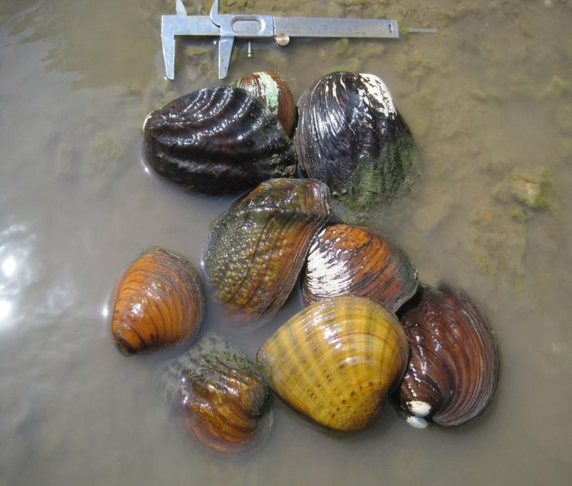
Freshwater Mussel Habitat Construction in the St. Louis District
Avoid and Minimize (A&M)
What are mussel habitat requirements?
Contract Ecological Specialists, Inc.
Mussel workshop, Alton IL,
August 9, 2013
Notes:
The goal is to ascertain whether the use of innovative river training structures might also be used to construct and create mussel habitat in the St. Louis district. So first and foremost, we asked the question, what are freshwater mussel habitat requirements? We contracted Ecological Specialists, Inc. (ESI) to compile a list of published literature on mussel habitat, with emphasis on the Upper Mississippi River Basin, including ideas for habitat construction projects in the St. Louis District. This final report was presented at a workshop in Alton Illinois last year. Many of you are likely familiar with this work, so I wont spend much time talking about this report, but will just sum it up over the next few slides.

Slide 2
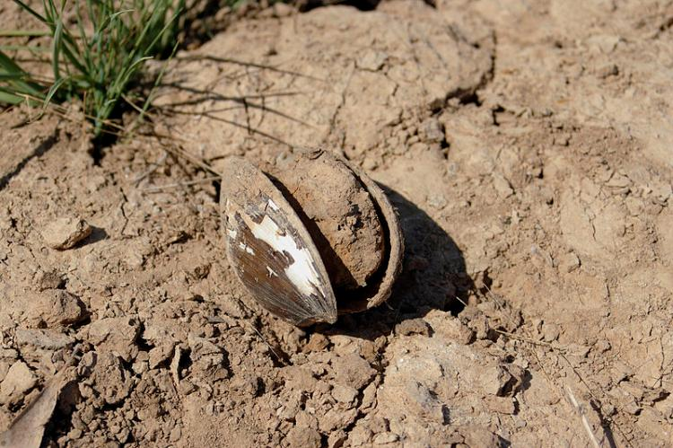
Habitat Requirements
Aggregations (mussel beds) have higher density than surrounding area.
Healthy beds constrained to stable areas of the riverbed.
Complex hydraulic variables combined with physical variables is best predictor of presence/abundance.
In general – moderate conditions are best.
Notes:
Freshwater mussel distribution and abundance is dependent on a complex suite of conditions due to their complex life history. They tend to form aggregations in rivers. These mussel beds generally have density much higher than the surrounding area; although lower density communities persist in the UMR and other rivers. Most healthy beds in large rivers are constrained to stable areas of the riverbed, which have physical boundaries defined by changes in a combination of substrate, depth, and velocity. According to the literature, predicting freshwater mussel distribution has proven difficult for researchers. Studies that did quantify simple variables met with limited success, Describing habitat with complex hydraulic variables in combination with other physical variables has generally been more successful in predicting mussel presence and distribution. In the end however, freshwater mussels are typically found under moderate conditions: moderate velocity, low fluctuation in velocity, heterogeneous substrate that is stable at high flow, but is loose enough for burrowing, and low amounts of smothering silt or sand.

Slide 3
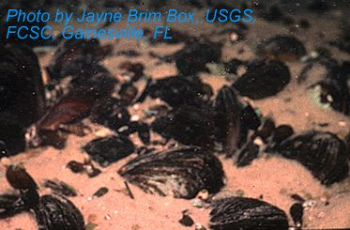
Habitat Creation Projects
Tombigbee River gravel bar
Lower Ohio River
Wolf Island side channel
Bertom & McCartney Lakes
Notes:
Only a small number of attempts have been made to create freshwater mussel habitat. The goal of the Tombigbee River project was to recreate a gravel bar that was inhabitated by mussels, fish, and other invertebrates. They used the concept of enough flow at low flow, and not too much at high flow to create an artificial habitat modeled after this natural one. This project was successful, and the created habitat was colonized by many different organisms, including mussels. In the lower Ohio River, artificial gravel beds were added between wing dikes to create mussel habitat. Similarly, the Wolf Island side channel project consisted of dumping dredged cobble and gravel in specific patterns in a side channel to create gravel shoals in an unstable side channel. The Bertom-McCartney lakes project attempted to create mussel habitat by modifying a side channel that generally had velocities deemed too high for mussel habitat. Bank was lined with a unique rock pattern, and a closing structure put in place. No monitoring of this project ever took place however.
(no follow up)

Slide 4
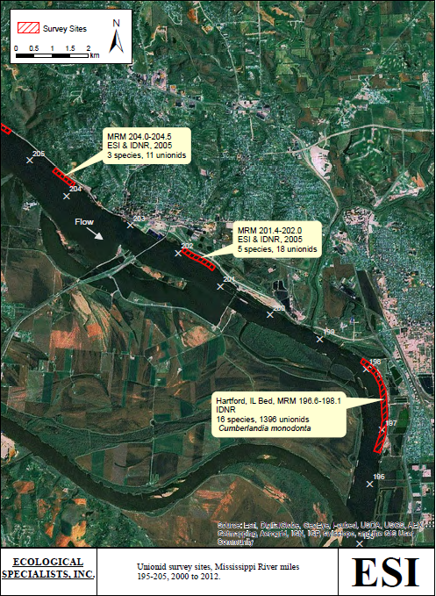
Habitat in St. Louis District
Pool 24
Pool 25
Pool 26
Middle River
Illinois River
Notes:
the hydraulic parameters that define habitat for freshwater mussels seem to be specific to a river reach, so an understanding of the habitat mussels occupy within the St. Louis district
is essential for the success of habitat construction projects. Regarding sampling done in Pool 24, most of the thalweg and channel borders were loose sand, which is unsuitable for mussels. However, 13 mussel beds are know to occur in the pool. In general, mussels were limited to small pockets within secondary or tertiary channels or in thin strips along the channel borders in silt/sand/clay substrate, although a few larger mussel beds occur in the upper portions of the pool with cobble, gravel, and sand substrate.
In Pool 25, at least 8 small, low density mussel beds are known to occur in this pool. As with Pool 24, mussels seem to be limited to areas near the banks with sand, silt, and clay substrates.
Regarding Pool 26, mussels were historically found along the channel borders and in side channels throughout the pool. Based on the 2005 IDNR survey, few mussels remain except in
small pockets.
The middle river historically did not harbor mussel communities due to the influx of sand and turbidity from the Missouri River. The only area recently sampled that mussels inhabited was the reach between Mel Price Lock and Dam and the mouth of the Missouri River along the Illinois bank. Habitat within the middle Mississippi River is more similar to the Missouri River than the pooled portion of the Mississippi River. Some mussel beds in the upper Mississippi River have persisted for many years due to the permanence of stable habitat areas. These stable habitats do not persist in the middle Mississippi River.
Historically, the Illinois River supported numerous species rich mussel beds, and 49 species were historically known from the river, including two federally endangered species. Current mussel communities in the Alton Pool of the Illinois River varied with respect to habitat/hydraulic characteristics. Some concentrations were along outside bends, some on inside
bends, some restricted to the sand, gravel, cobble riverward, and others to the silt, sand, clay near the bank.

Slide 5
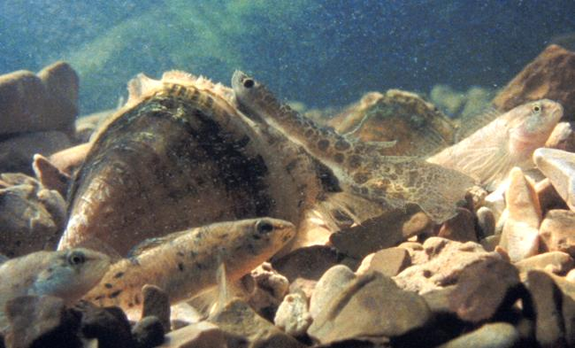
Habitat Creation
Habitat in MVS is poor, creation of large mussel beds unlikely.
Modified river training structures create flow refugia – could benefit mussels.
Chevron, round point, bullnose dikes.
Gravel bar habitat.
Notes:
In general, habitat within the St. Louis district is poor compared to other areas of the UMR. According to ESI, creation of large mussel beds is likely beyond expectations, however, creating small areas attractive to mussels may be possible around existing or future river training structures. The diversion of flow seems to be associated with flow refugia. It therefore seems feasible that river training structures can be modified to create flow refugia or increase flow in depositional areas for the benefit of mussels. Habitat could be created by configuring chevron, round point, or bullnose dikes in channel borders to create flow refugia in areas with unstable substrate or increase flow in depositional areas. Conditions that would divert the core flow, yet have critical shear velocity sufficient to flush silt and fine sands from the substrate during low flows would need to be created. Placement of a heterogeneous mix of river rock sizes and sand within the refugia might also be necessary to stabilize the substrate. Gravel bar habitat could also be created within the chevron dike structure. A few notches could be placed in key areas to provide flow. The structure could be filled in with a variety of river rock sizes and sand. A low flow channel could be engineered that prevents silt
deposition but is sufficient to prevent scour of larger particle sizes similar to the Tombigbee gravel bar.

Slide 6
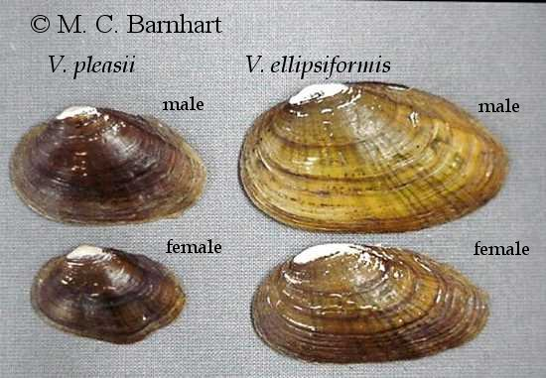
Moving Foward
Facilitate meetings.
Investigate selected sites.
Report of survey results.
Notes:
Now moving on to the next steps. We are planning on setting up a pre-sampling meeting to select sites specific to Pools 24-26 that would be used for investigation of mussel colonization and habitat suitability, and determine sampling strategies for the selected sites. The selected sites would be investigated as described in the sampling strategies outlined from the pre-sampling meeting. Following the site selection and sampling, the Corps would perform hydraulic surveys would be incorporated with the sampling results and discussed during a post-sampling meeting. A final report combining and analyzing mussel data and hydraulic modeling from all phases of the study would then be prepared.

Slide 7
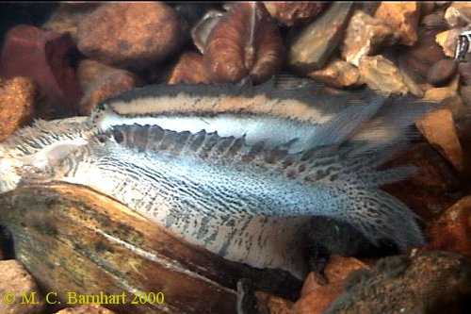
Pre-sampling
Facilitate meeting:
Select sites for investigation of colonization and habitat suitability.
Determine sampling strategies for selected sites.
Notes:
So before sampling begins, we will conduct a one-day meeting with the Corps and other state and/or federal agency personnel to select sites and develop a sampling strategy. The meeting will be lead by the project malacologist, and will be held within the St Louis District. During this meeting, atendees will select five sites with river training structures within pools 24-26 to determine whether mussels have colonized; existing habitat appears to have the potential for mussel colonization; or, the addition of some rock to add substrate stability could potentially create mussel habitat. Furthermore, we will develop a sampling strategy to assess habitat quality/quantity at the five selected sites. The sampling strategy will include which sites to sample, what hydraulic/biological information is needed, and what sampling intensity is required.
(STRESS – WHERE ARE WE GOING TO LOOK? WHY? HOW CAN WE USE THIS TO CREATE HABITAT?)

Slide 8
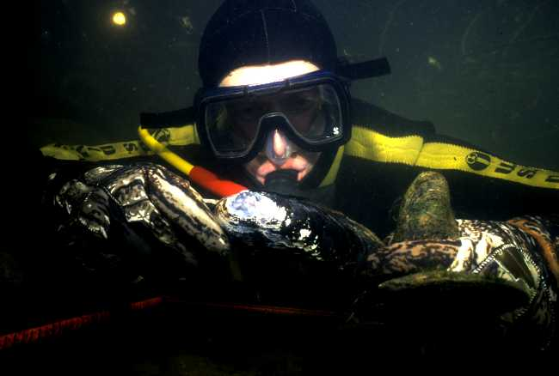
Sampling
Two days at each of the five sites.
Habitat conditions.
Substrate stability.
Presence/absence.
Hydraulic parameters.
Notes:
Biological sampling will include two days of sampling at each of the five selected sites to evaluate habitat conditions, substrate stability, and presence/absence of mussels at each site.

Slide 9
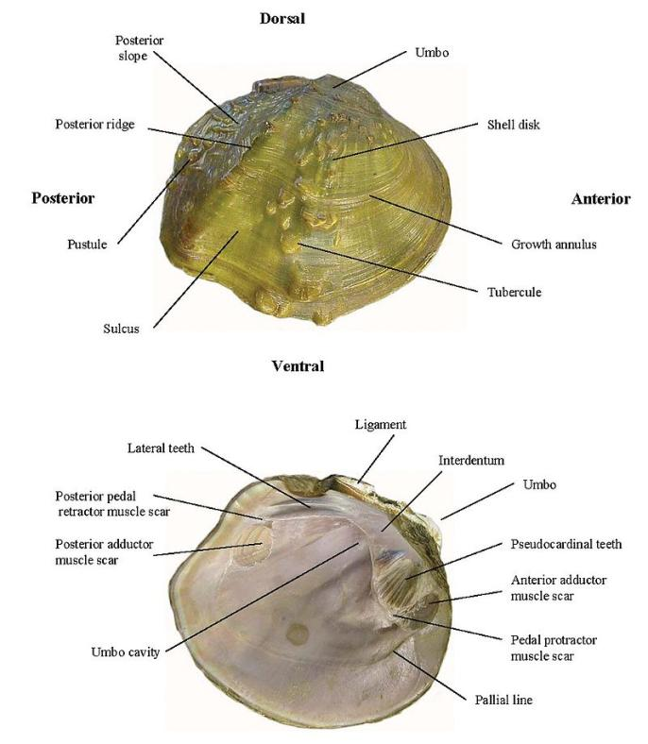
Post-sampling
Post sampling meeting.
Freshwater mussel summary report.
Data analysis results:
Map of mussel distribution
Map of habitat conditions
Tables of mussels species, age structure, relative abundance.
Notes:
The contractor shall prepare a comprehensive Freshwater Mussel Summary Report which will combine and analyze mussel data and hydraulic modeling from all phases of the study, define mussel communities, habitat, and hydraulic conditions within and around the five selected sampling sites, and determine if sites currently provide or have the potential to provide mussel habitat. Additionally, the report shall make specific suggestions for substrate enhancement, fish attractors, Monitoring, and modification of future structures. Geospatial Survey Data will be collected and stored in GIS format using a standardized ESRI shapefile. Data Analysis will include the following for each site:
• Data Analysis will include the following for each site (CUT THIS DOWN – TOO WORDY)
• Map of Mussel distribution
• Map of habitat conditions (depth, flow, substrate characteristics)
• Tables of mussel species, age structure, relative abundant of species
The contractor, in coordination with the Corps, shall schedule, facilitate, and document one post-sampling meeting that will result in Post-Sampling Meeting Minutes, and comprehensive Freshwater Mussel Summary Report. The contractor shall provide maps of areas with potential biological and hydraulic habitat after data analysis is complete.

Slide 10
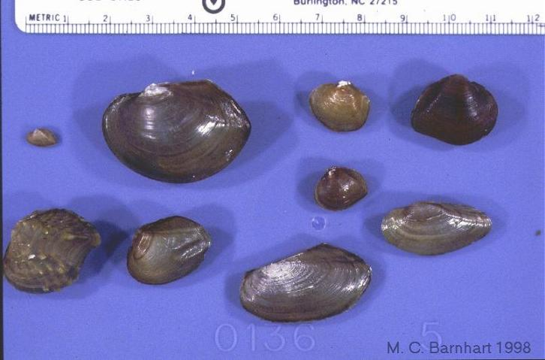
Conclusion
Better management practices.
Better support the Endangered Species Act.
Pictures from: Barnhart, M. C. 2008. Unio Gallery: http://unionid.missouristate.edu
Notes:
The products from this work would enable the Corps to develop adaptive management practices and aid in design of future channel improvement structures in the upper Mississippi River. Additionally, the results would allow the Corps to better support the Endangered Species Act. This study should provide information which would improve our ability to conserve endangered and threatened mussels.

