Slide 1
St. Louis District Gilbert Island RRAT
Notes:
Introduce self.
Thank you for the opportunity to talk to you today about Low Water Reference Plane.

Slide 2
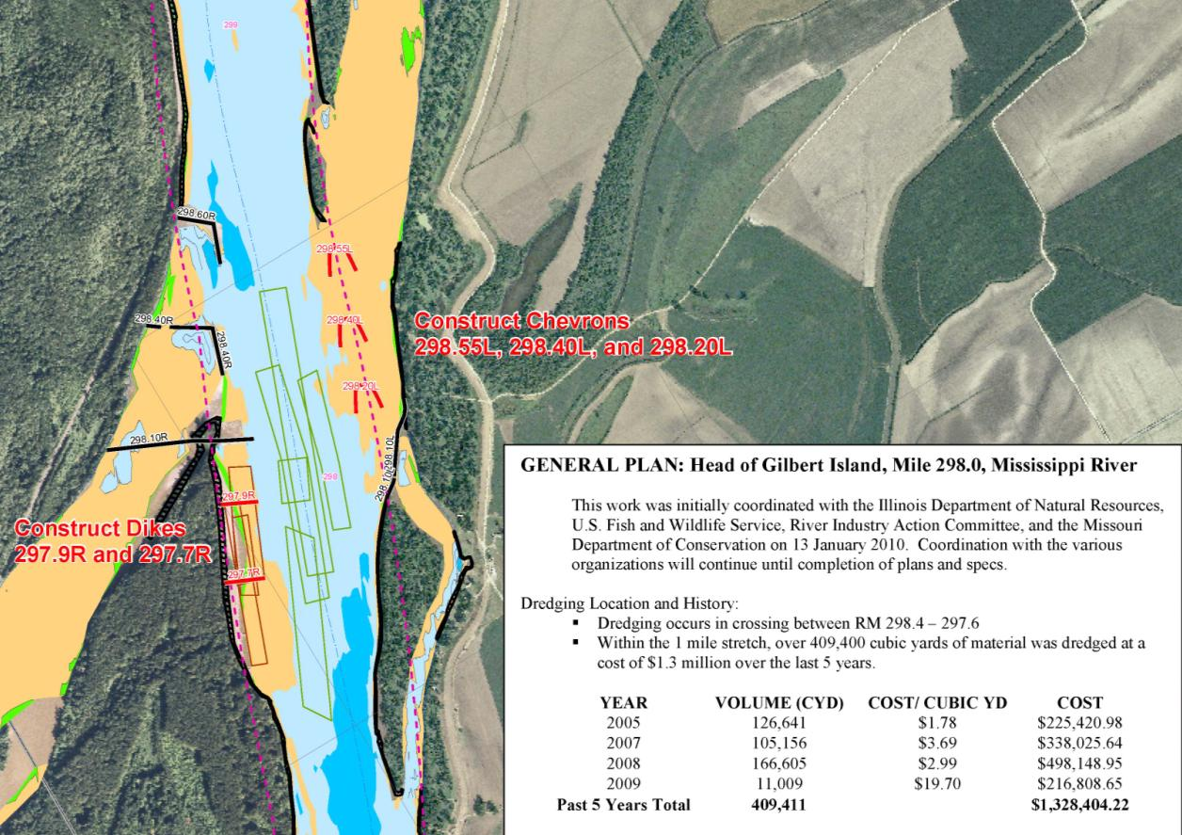
FY 14 RRAT– Gilbert Island

Slide 3
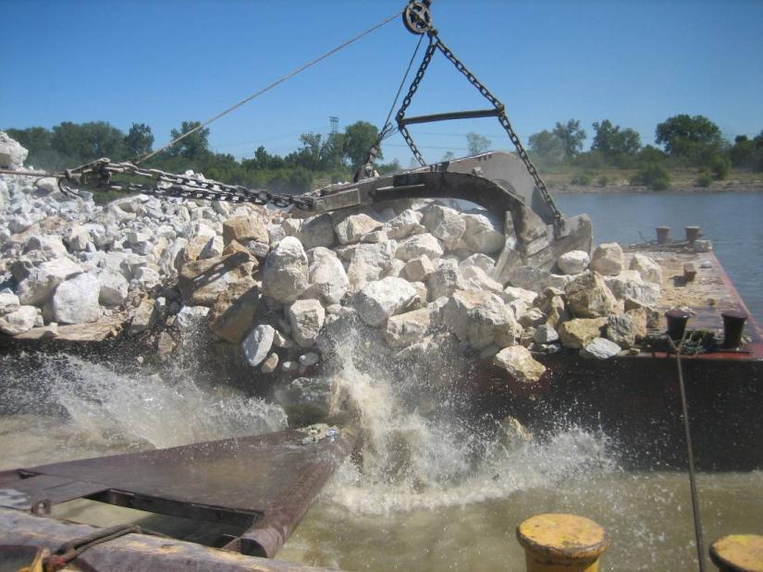
FY 14 RRAT– Gilbert Island
Chevrons 298.55L & 298.4L along with Dikes 297.9R & 297.7R were completed in the spring of FY11 ($1.5M)
So far the third chevron, 298.2L is not needed.
Uppermost location in MVS, by alleviating dredging at this location mobilization costs for the dredge have been significantly reduced
Mussel habitat identified on the LDB
FY14 award to include mussel survey work in FY15

