Slide 1
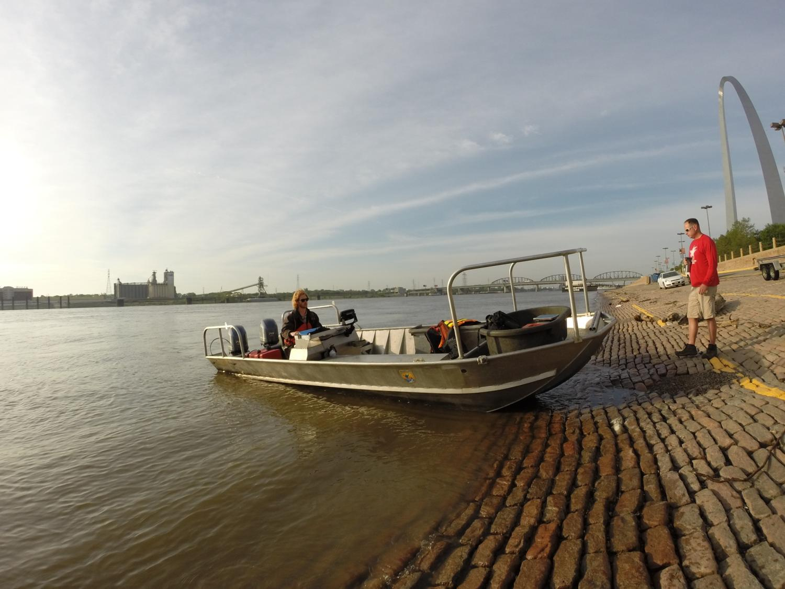
FWCO FALL2013/SPRING2014 MMRPM
Summary of Effort and Catch
River Resources Action Team 2014

Slide 2
Sampling Effort
Fishing with trotlines to catch sturgeon
Chain of Rocks, Kaskaskia River Confluence, Cottonwood Island, Marquette Island, Bumgard, and Ohio River Confluence
Started 6 November and ended on 19 December 2013
Started 11 March and ended on 15 May 2014
The 2013 end date and 2014 start date determined by water temperatures

Slide 3
Sampling Effort
Sampling was a cooperative effort between the Army Corps of Engineers, Missouri Department of Conservation, and the U.S. Fish and Wildlife Service
5 weeks in 2013 and 11 weeks in 2014
5 work days/week on river if weather allowed
Work day from 8 to 12 hours, average 10 hours
4,182 field staff hours jointly for MDC and USFWS

Slide 4
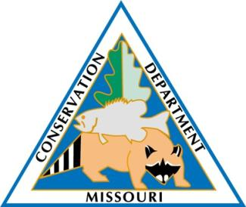
Sampling Effort
Sampling Reaches and Crews
 | Chain of Rocks | Kaskaskia River Conf. | Cottonwood Island (Grand Tower) | Marquette Island | Bumagard | Ohio River Confluence
ACOE | X |  |  |  |  | X
MDC |  |  |  | X | X | X
USFWS | X | X | X

Slide 5
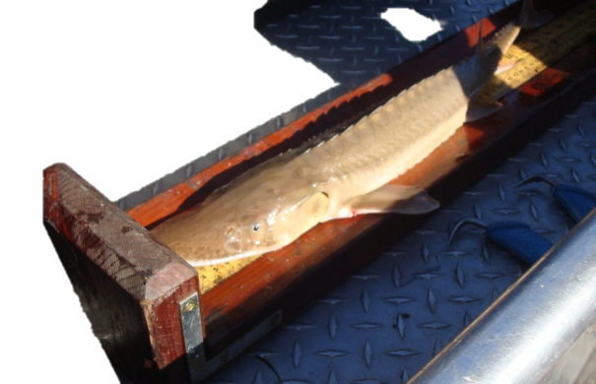
Catches in General
11,037 fish of 16 species during 2013 and 2014 combined
7,934 shovelnose sturgeon
65 pallid sturgeon/hybrids
10 lake sturgeon
Blue catfish was the second most caught fish
Channel catfish was the third most caught fish
FL measured for all sturgeon, TL measured for all other fish
All species of sturgeon tagged with Floy tags
Spine taken from 150 first shovelnose and all pallid and lake

Slide 6
Catches - Recaptures
Shovelnose
240 or 3.2% sampled were recaptures
66 or about 0.90% were recaptures of fish we had tagged
Lake sturgeon
1 of the 9 was a recapture
Pallid sturgeon
No Floy tag recaptures but one had CWT, one had elastomer, and two had scuts removed

Slide 7
Shovelnose Movement
Original tagging and recapture location of shovelnose sturgeon.
Recapture Location | Original Tag location
 | Chain of Rocks | Kaskaskia | Cottonwood | Marquette | Bumgard | Ohio River conf
Chain of Rocks | 11 | 4 | 2 | 1 | 0 | 0
Kaskaskia | 0 | 10 | 0 | 0 | 0 | 0
Cottonwood | 1 | 0 | 21* | 3 | 0 | 1
Marquette | 0 | 0 | 0 | 8 | 0 | 0
Bumgard | 0 | 0 | 0 | 1 | 5 | 0
Ohion R Confluence | 0 | 0 | 0 | 0 | 0 | 0
*Including a double recapture. The original tagging location is currently unknown.
37 (black) shovelnose sturgeon were recaptured at original capture location
11 (brown) shovelnose sturgeon were recaptured at an upstream location
Only 2 (red) shovelnose sturgeon were recaptured at a downstream location

Slide 8
Pallid sturgeon
For all pallid sturgeon and those believed to be hybrids:
Scanned for CWT and PIT tags
Morphometric measurements taken
Tagged with floy tags
Tagged with pit tags
Tissue sample (fin clip) taken
Spine sample taken
Pictures taken of morphometric features

Slide 9
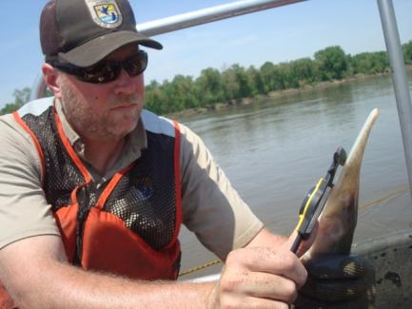
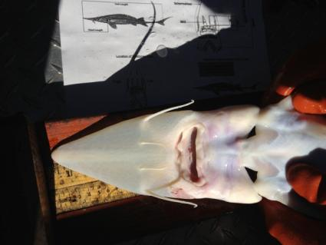
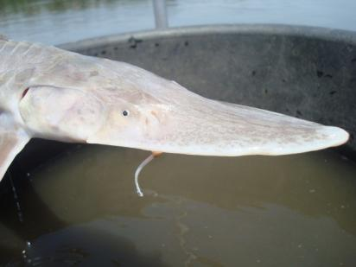

Slide 10
Total pallid sturgeon catches
65 pallid sturgeon incl. hybrids combined for 2013 and 2014
4 at Chain of Rocks
3 at Kaskaskia River
21 at Cottonwood Island
14 at Marquette
13 at Bumgard
10 at Ohio River Confluence
None were recaptures
Averaged 733 mm (SD=88.8 mm) fork length
Smallest at 526 mm FL at Marquette
Largest at 1000 mm FL at Chain of Rocks

Slide 11
Information from Data
Ageing of pallid and shovelnose from fin clips
Development of age-growth relationships
River origin and movement from microchemistry of fins clips
Genetics to determine hybridization
Genetics to determine hatchery origin
Further refine morphometric characteristics

Slide 12
This Year’s Surveys
Continue sampling at all six reaches
Modify sampling at Cottonwood Island to increase capture and recapture for abundance estimate
Include use of ultrasound and plasma sex steroids (blood sample)
Sex ratio
Maturation stage
Estimate age at maturity, years between reproductive events

Slide 13
Three Year Project
Slowly collect data that can be used to piece together pallid sturgeon population dynamics, life history, and trends.

