Slide 1
St. Louis District
Regulating Works
RRAT
Notes:
Introduce self.
Thank you for the opportunity to talk to you today about Low Water Reference Plane.

Slide 2
Execution CG
Regulating Works (195-0)
  FY13 - $9.2M Budget plus $3.2M FY12 contract T for C’d ($12.5M total)
    $8.5M on Rock Removal Urgent & Compelling
    $1M on Rock Removal Phase 2
    $650k on 3 HSR Model Studies – (Mouth of the Meramec RM 165,
    Gray’s Point RM 53, Upper Browns Bar RM 29)
  FY14 - $31M Budget
    $18M on Rock Removal Phase 2
    $1.5M on SEIS
    $3.3M on Mosenthein Phase 4
    $2.9M on Dogtooth Bend Phase 5
    $1.6M on Eliza Point Phase 3
  FY15 - $9M Budget
    $5.5M on Grand Tower Phase 5
    $1.1M on SEIS

Slide 3
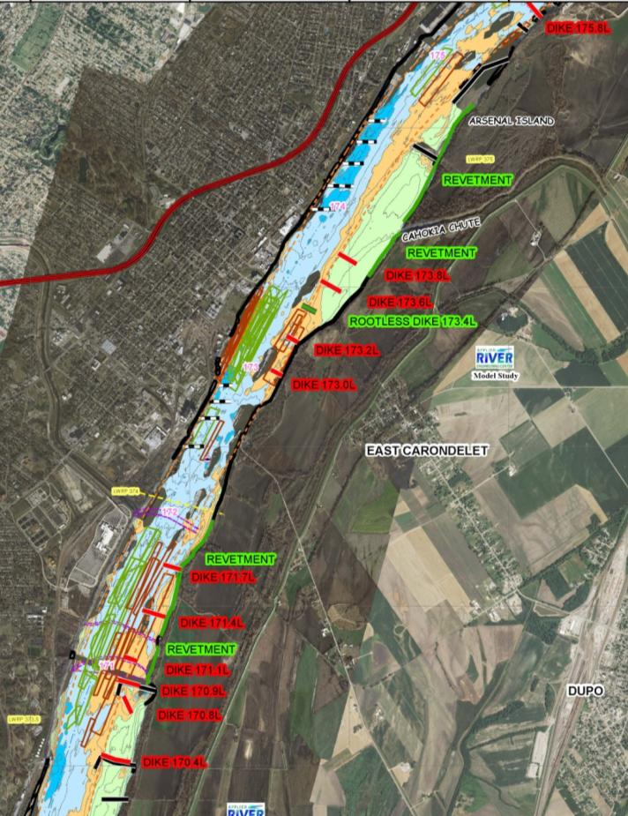
FY 14 Workload CG – Mosenthein Phase 4
RM 175 - 171
We have seen a systematic increase in channel width over the last 10 years leading to additional maintenance dredging required.
Design includes the construction of Rootless Dike 173.4L and over 2 miles of revetment on the LDB from RM 175 – 173.8 and RM 172 – 171.
The total project cost is $3.3M
This project combines the Carondelet GP from 2013 and Mosenthein GP from 2011

Slide 4
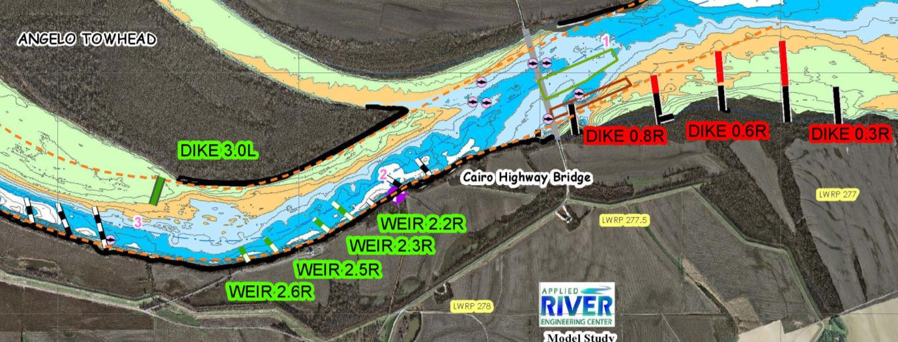
FY 14 Workload CG – Eliza Point Phase 3
RM 3 - 0
Address a repetitive dredge location and provide better channel alignment.
We have dredged over 300k cy since 2007 at a cost of $900k.
Design includes the construction of 4 weirs and 1 dike
The total project cost is $1.6M
The GP was approved at E-Action in 2012

Slide 5
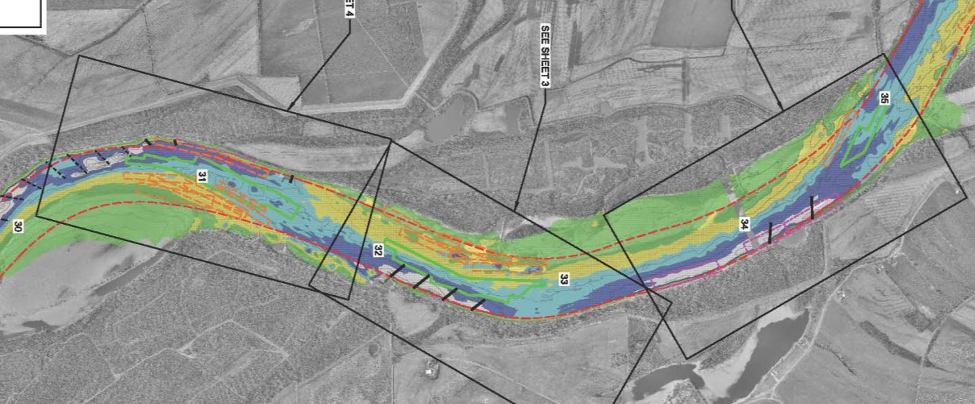
FY 14 Workload CG – Dogtooth Bend Phase 5
RM 35 - 30
Address a repetitive dredge location and provide better channel alignment.
We have dredged approximate 1.5M cy since 2006 at a cost of $2.8M.
Design includes the construction of 8 weirs and 1 dike
The total project cost is $2.9M
The GP was approved at E-Action in 2012

Slide 6
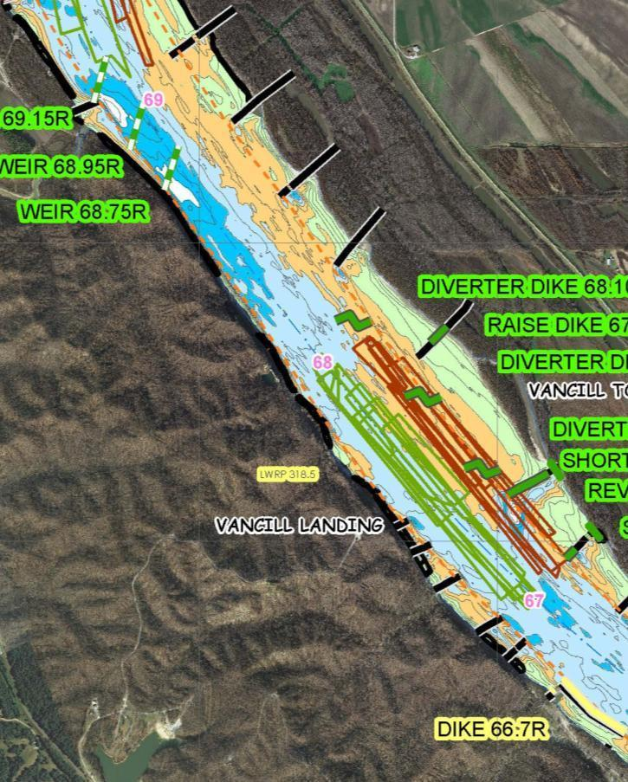
FY 15 Workload CG – Grand Tower Phase 5
RM 75 - 66
- Address a repetitive dredge location and provide better channel alignment.
Design includes the construction of 2 chevrons, 3 weirs, 3 diverter dikes, 1 dike extension, and 2 dike shortenings.
The total project cost is estimated at $5.5M.
The GP was approved at E-Action in 2012.

Slide 7
Why is Regulating Works Important

Slide 8
Measuring Success
Dredging Reduction 1988/1989 – 2012/2013:
- Dredge volume decreased
- Channel maintained to deeper depths
- Channel maintenance cost was reduced
Increased channel reliability
Improved safety – Zero in channel groundings during low water period.

Slide 9
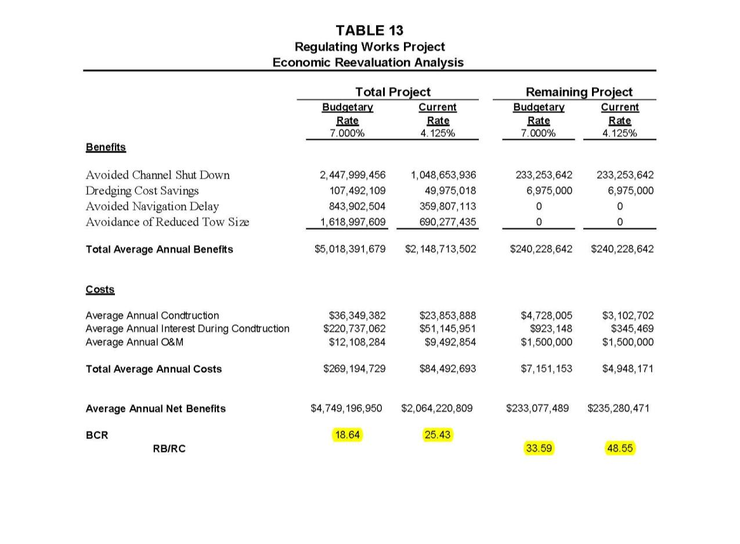
Regulating Works Project Benefits vs. Costs

Slide 10
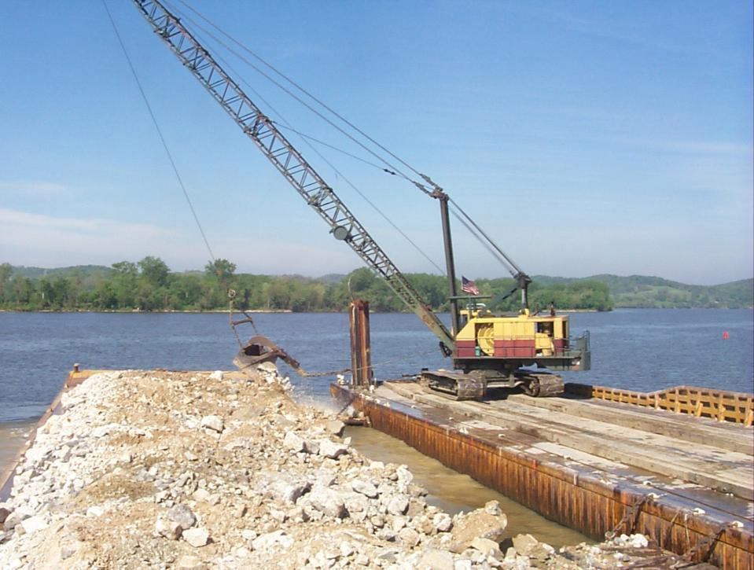
Questions??

