Slide 1
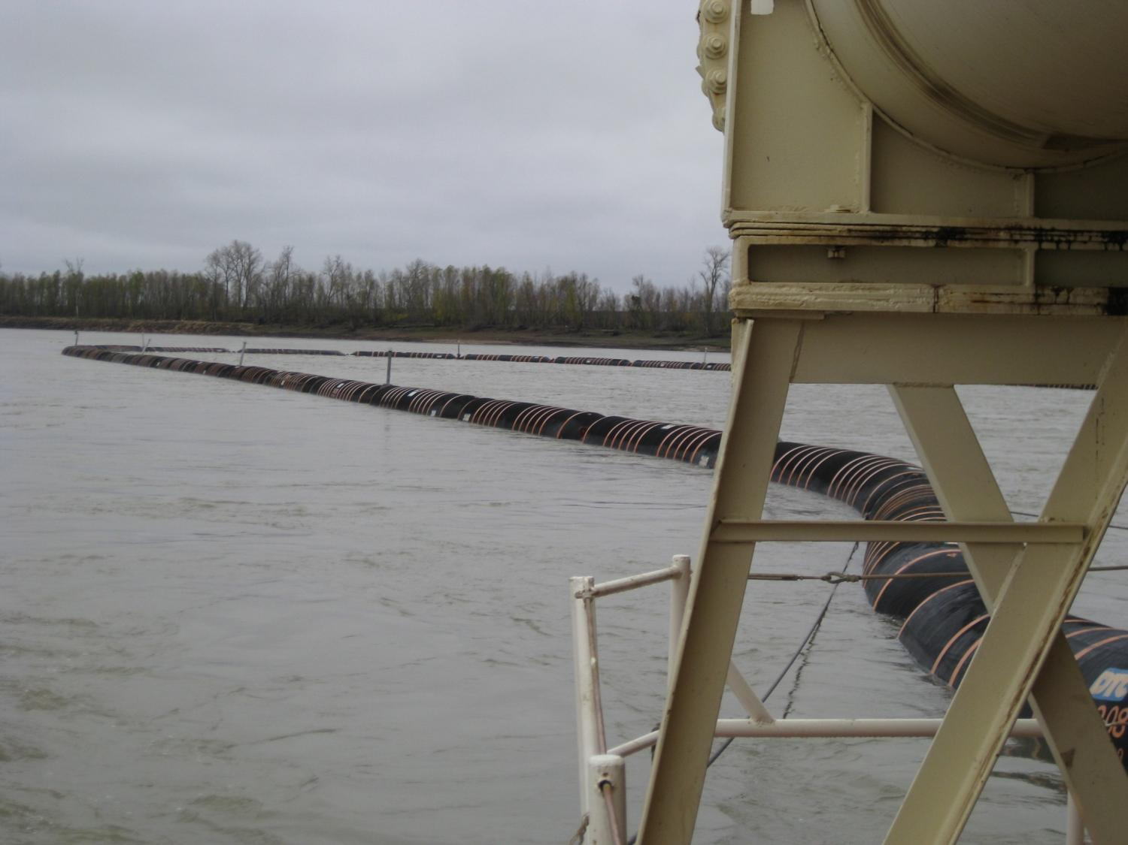
Flex pipe
2009 - MVS purchased
2600 ft of flexible, floating, dredge disposal pipe.
Aimed at creating island and sandbar habitat, increasing habitat diversity.
In general – gives us many options for placing dredged material for ecological benefits.

Slide 2
2011 - Construction of a temporary spill barge completed.
Successful test done in September.
A permanent spill barge is in the process of being procured.

Slide 3
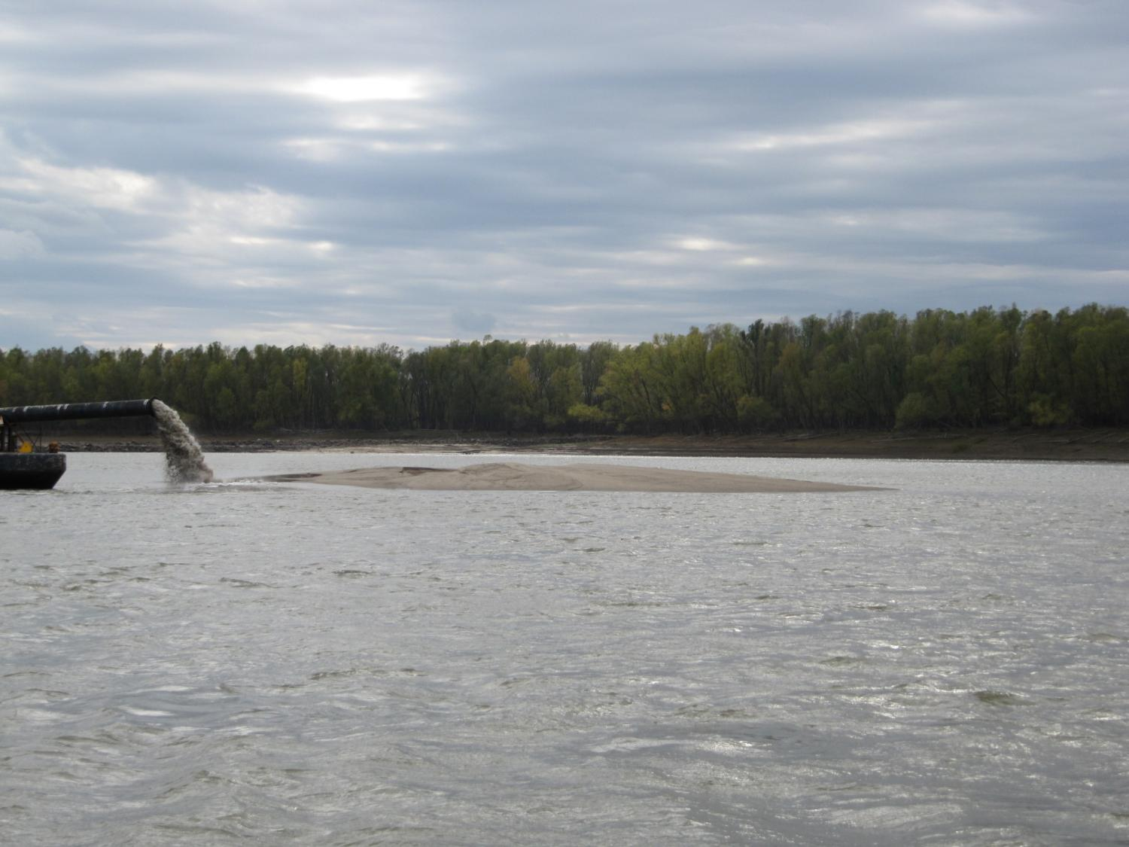
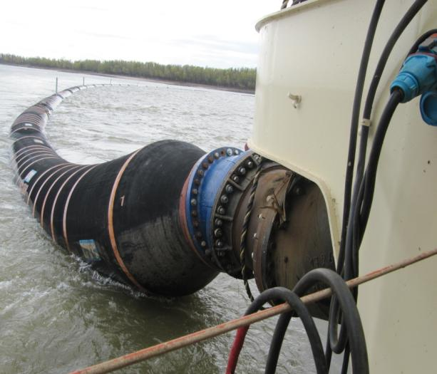
MVS coordinated with stakeholder agencies to identify pilot study area.
November 2011-Flex pipe was used to create an ephemeral island at RM 104(R)
Approximately 100,000 cubic yards used to create island, 10 acres in size, +15 LWRP

Slide 5
Test operation was a success.
Flex pipe can be used to create habitat while maintaining the navigation channel.
Moving forward – examine the viability of using flex pipe with chevrons

Slide 6
September 2013 – 100,000 cubic yards of dredge
material was placed Inside the chevron at RM 103.7(R)
Post placement bathymetric surveys
took place in 2014.

Slide 7
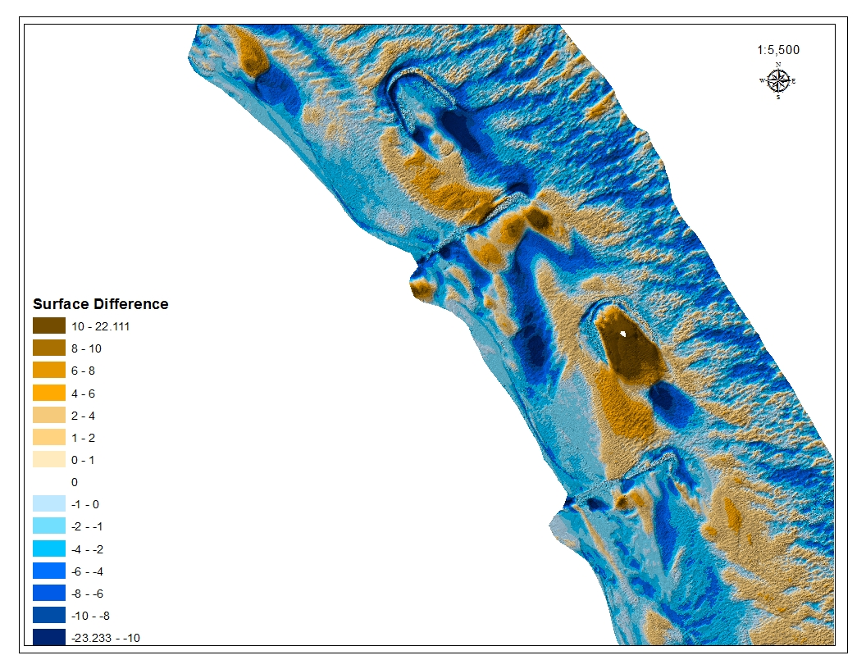

Slide 8
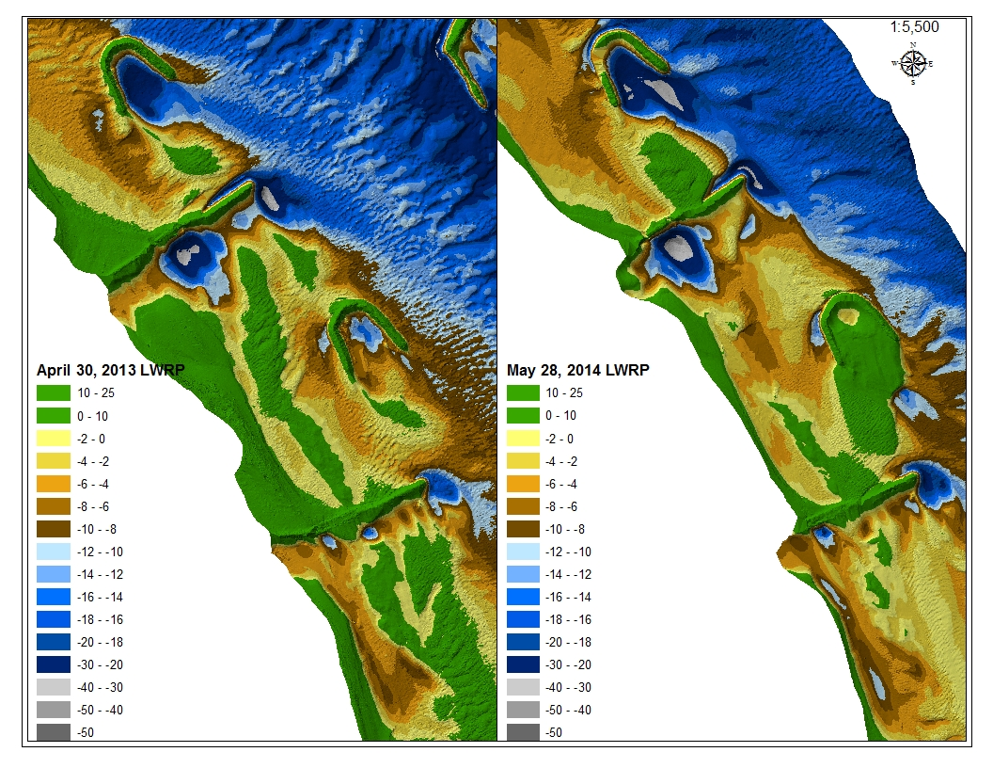

Slide 9
We hope to utilize flex pipe more regularly for
habitat creation projects.
Near future objectives are to select sites for longer-term,
large-scale biological and bathymetric study.

